Slide 1
The Third AI Summer
AAAI Robert S. Engelmore Memorial Lecture
Director’s Cut
Henry Kautz
Director, Information & Intelligent Systems, National Science Foundation
Professor, University of Rochester

Slide 2
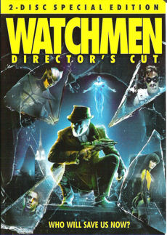


Director’s Cut
Numerous corrections!
Hidden slides revealed for the first time!
Three entirely new slides!

Slide 3

Greatest Hits?

Slide 4
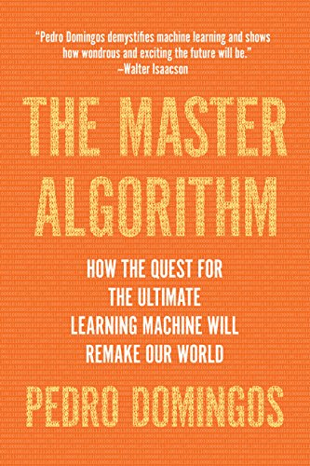
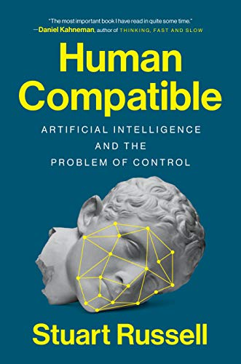
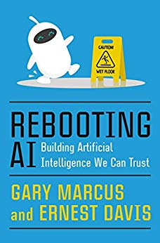
Big Picture?
History?
Dangers?
Future?

Slide 5
Three in One
Part I: History of AI
Part II: AI for Bad
Part III: Future of AI

Slide 6
Part I: History of AI

Slide 7
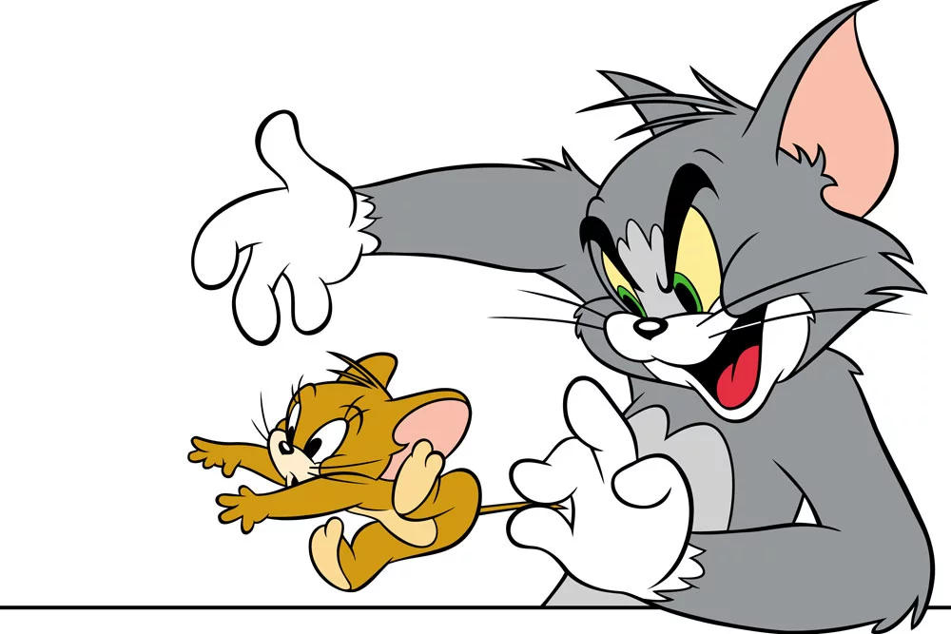
The Cartoon History of AI
Symbolic AI
Neural Networks

Slide 8
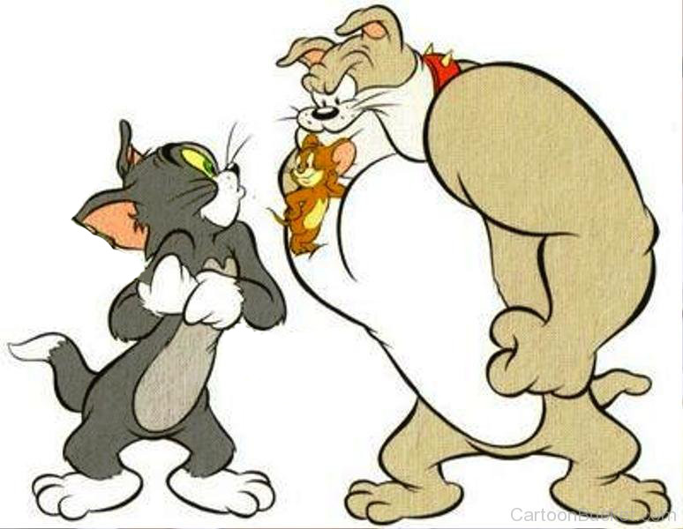
The Cartoon History of AI
Deep Learning
Neural Networks
Symbolic AI

Slide 9
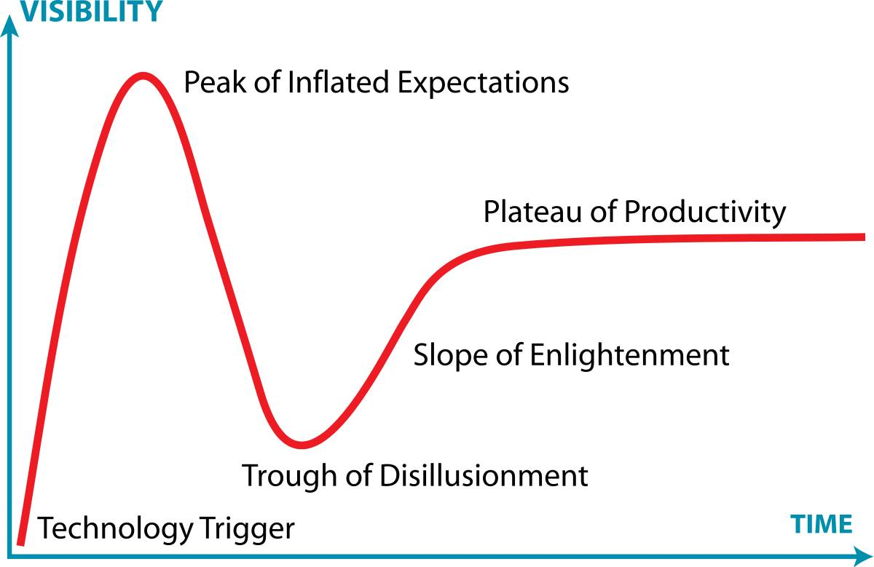
AI Summers and Winters
Enthusiasm, funding, and approaches to AI have been cyclical
Enduring insights have blossomed in each summer
Gartner Hype Cycle

Slide 10
Overview
Overview of a few of the enduring insights from each AI summer
First Summer: Irrational Exuberance (1948 – 1966)
First Winter (1967 – 1977)
Second Summer: Knowledge is Power (1978 – 1987)
Second Winter (1988 – 2011)
Third Summer (2012 – ?)
Why there might not be a third winter!

Slide 11

First Summer: Irrational Exuberance (1948 – 1966)
William Walter Grey’s Tortoises

Slide 12
Insight 1: The Tortoise’s Legacy
1A: Artificial Neural Networks
1B: Behavior = Agent + Environment
McCulloch & Pitts neuron (1943)
Perceptron: Single-layer learning (Rosenblatt 1958)
Backpropagation: Multi-layer learning (Werbos 1974; Rummelhart, Hinton, Williams 1986)
Parameter sharing: Convolutional networks (Fukushima 1980; LeCun 1989)
Self-organizing machines (Turing 1948)
Dynamic programming (Bellman 1957)
Temporal difference learning (Witten 1977; Sutton & Barto 1981)
Self-play (Samuels 1959; Tesauro 1992)

Slide 13
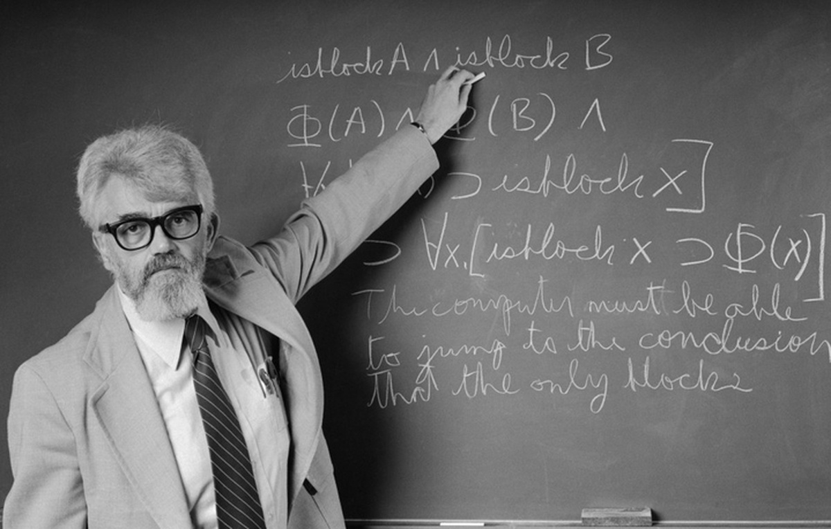
Insight 2: Declarative Knowledge Representation
Logic Theorist: Mathematical theorem proving (Newell, Shaw, & Simon 1956)
Advice Taker: Commonsense knowledge (McCarthy 1958)
Semantic networks: Graph representations (Richens 1958)
KL-ONE: Object-oriented logic (Brachman 1977)
Bayesian networks: Probabilistic graph representations (Pearl 1985)
Probabilistic relational models
(Friedman et al. 1999)
Knowledge graphs (Google 2012)
John McCarthy

Slide 14
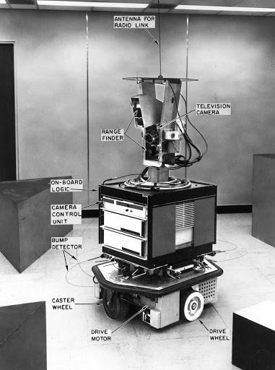
Insight 3: Efficient Combinatorial Search
Game-tree search (Samuels 1952)
Model finding (Davis, Putnam, Logemann, & Loveland 1962)
A* (Hart, Nilsson, & Raphael 1968)
Means-ends analysis (Newell, Shaw, & Simon 1960; Nilsson et al. 1969)
Hierarchical planning (Tate 1975)
Conflict-driven learning (Marquis-Silva & Sakallah 1996)
Planning as satisfiability (Kautz & Selman 1992)
Local search for SAT (Selman & Kautz 1993)
Optimization with parity constraints (Ermon et al. 2013)
Shakey the Robot

Slide 15
First Winter (1967 – 1977)
DARPA funding cuts
  Early failure of practical speech recognition and autonomous tank project
  Mansfield Amendment (1969) mandated that DARPA stop funding basic undirected research
United Kingdom: Lighthill Report (1973)
  Criticized failure of AI outside of toy micro-worlds
  Claimed AI could never tame combinatorial explosion of real-world domains
  Complete dismantling of AI research in UK

Slide 16
Second Summer: Knowledge is Power (19[67]8 – 1987)
MYCIN (Shortliffe & Buchannan 1976)

Slide 17
Second Summer: Knowledge is Power (19[67]8 – 1987)
MYCIN (Shortliffe & Buchannan 1976)

Slide 18
Insight: Modeling Expert Knowledge
Knowledge Engineering
Dendral (Feigenbaum et al. 1968)
MYCIN (Shortliffe & Buchannan 1975)
XCON (Dermott 1978)
Knowledge Induction
Decision tree learning (Quinlan 1986)
Inductive logic programming (Muggleton 1991)
Decision-theoretic expert systems
(Heckerman, Horvitz, Nathwani 1992)
Edward Feigenbaum

Slide 19
Second Winter (1988 – 2011)
Knowledge-engineered expert systems proved costly to maintain
Collapse of market for specialized AI workstations
Failure of Japan’s Fifth-Generation AI effort based on Prolog hardware and software

Slide 20
Third Summer: Deep Learning (2012 – ?)
China’s Sputnik Moment

Slide 21

Third Summer: Deep Learning (2012 – ?)
China’s Sputnik Moment

Slide 22
Insight 1: Hierarchical Representation Learning
While knowledge representation was all about capturing hierarchies…
Traditional machine learning considered only two levels of representation: feature and class
Deep learning’s innovation was to learn hierarchical representations
Image by Honglak Lee et al. (2011)
Figure from Kautz (1987)

Slide 23
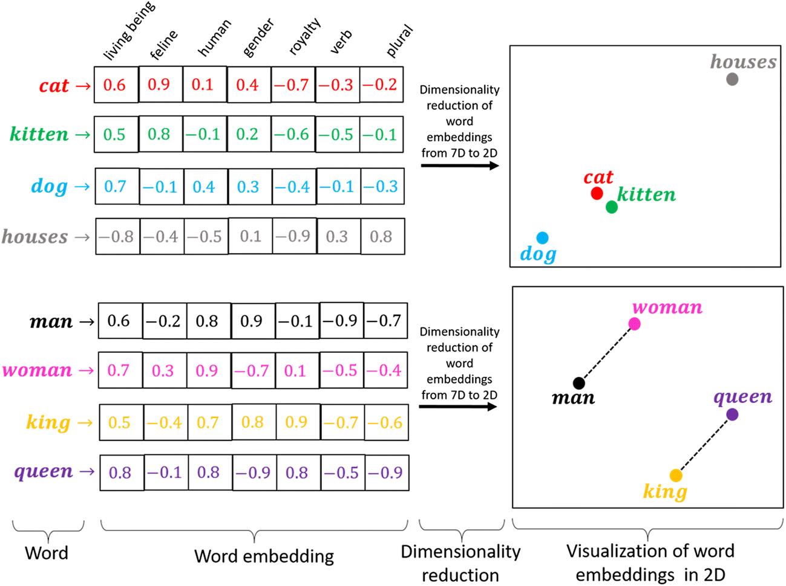
Insight 2: Similarity
Deep learning representations directly support concept similarity
Reasoning about similarity is vital for most real-world domains
Not captured by probability!
Image by David Rozado (2019)

Slide 24
Why Winter Might Not Return
The World’s Unreasonable Predictability
Truly unreasonable – who would think that “statistical monkeys at typewriters” could produce paragraphs of coherent prose?
  Prompt: In a shocking finding, scientist discovered a herd of unicorns living in a remote, previously unexplored valley, in the Andes Mountains. Even more surprising to the researchers was the fact that the unicorns spoke perfect English.
  GPT-2: … While examining these bizarre creatures the scientists discovered that the creatures also spoke some fairly regular English. Pérez stated, “We can see, for example, that they have a common ‘language,’ something like a dialect or dialectic.” Dr. Pérez believes that the unicorns may have originated in Argentina, where the animals were believed to be descendants of a lost race of people who lived there before the arrival of humans in those parts of South America.

Slide 25
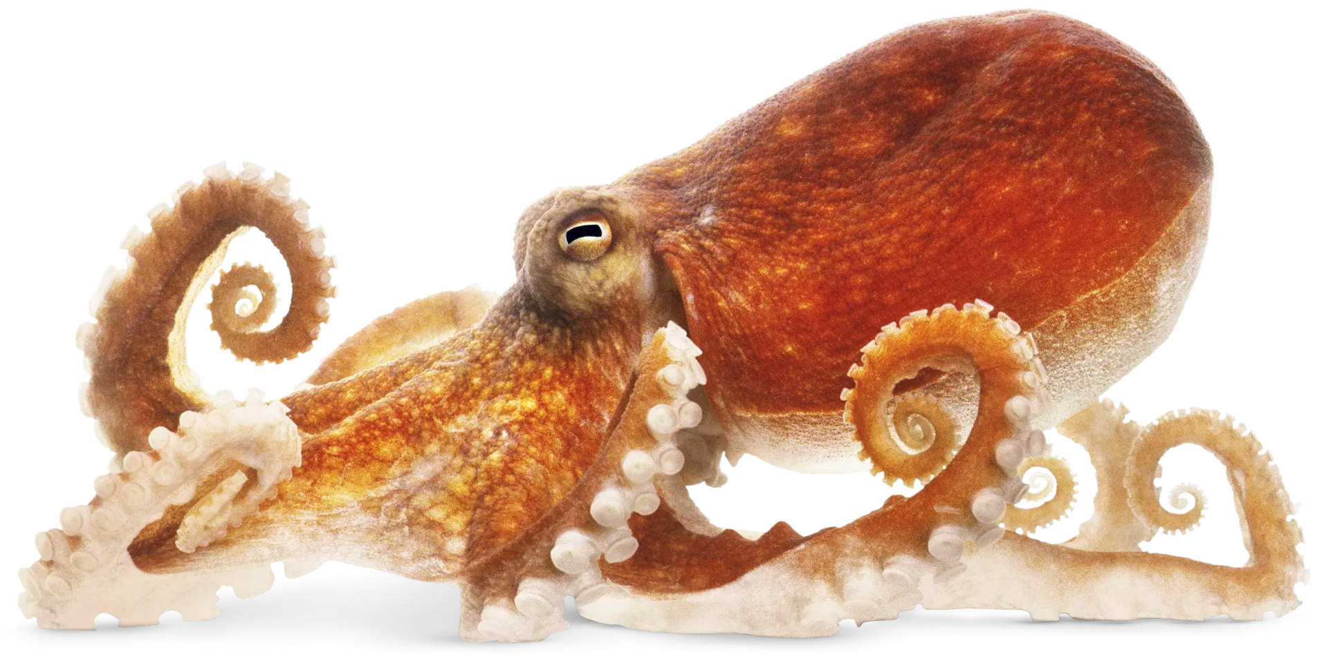
Non-Human Intelligence
Deep learning can create a simulacra of human intelligence, without being anything like human intelligence
Compare with octopus intelligence
  Could a creature with a lifespan of 3 years, which cannibalizes the male after mating, and spawns 70,000 offspring ever really understand you?
But an octopus’ brain is more like a human brain than is any deep learning systems!

Slide 26
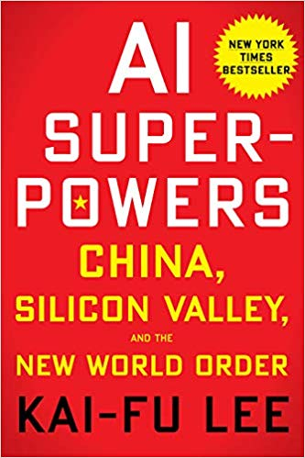
It Just Works
Despite being utterly unlike human intelligence, today’s AI can drive powerful applications for good or for evil
AI supremacy == world supremacy?
Growing number of workshops and
conference tracks on AI for Good
So let’s turn to …

Slide 27
Part II: AI for Bad

Slide 28
Overview
Dangerous applications are enabled by third summer AI
Threats most prominent in the news might not be the worst!
Three examples:
  Face recognition
  Fake news
  Autonomous weapons

Slide 29
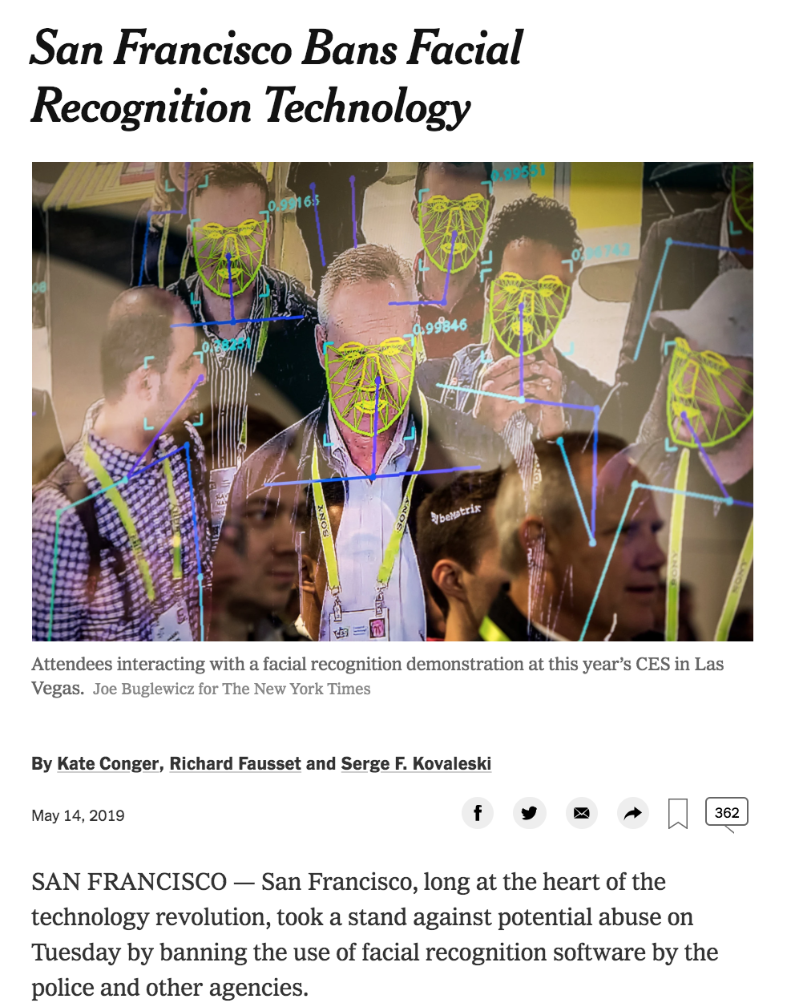
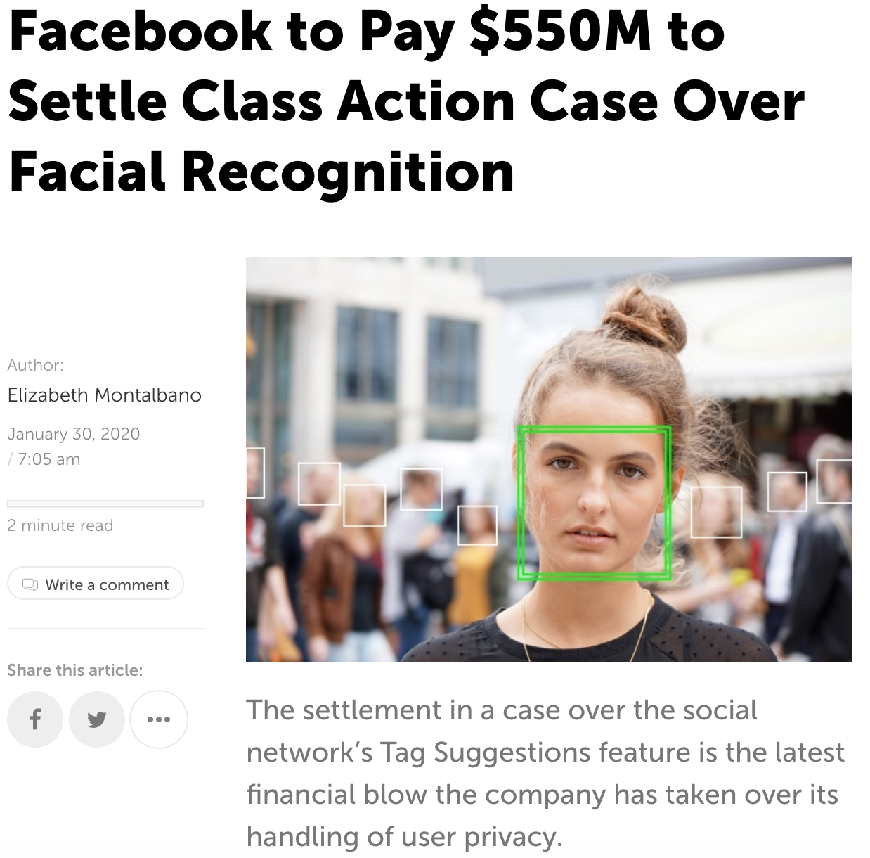
In the News: Keeping Your Face Private

Slide 30
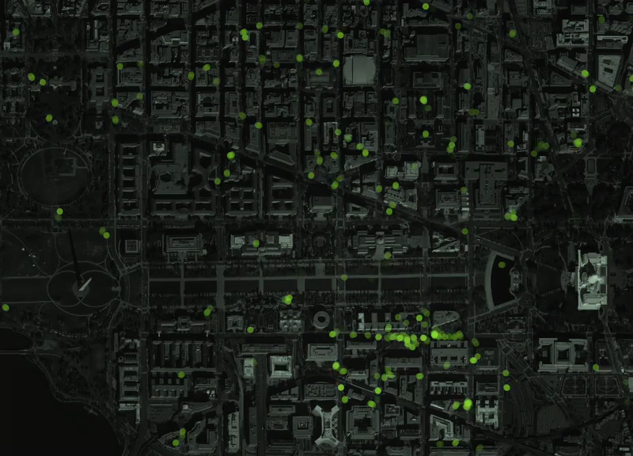
In the News: Keeping Your Face Private
Face Recognition == Threat
But your mobile phone apps are giving your location away – no AI needed!
A. Sadilek, H. Kautz & J. P. Bigham (2012), Finding Your Friends and Following Them to Where You Are
L. Liao, D. J. Patterson, D. Fox, and H. Kautz (2007), Learning and Inferring Transportation Routines
New York Times, “Twelve Million Phones, One Dataset, Zero Privacy”, Dec. 19, 2019

Slide 31
Greater Threat: Keeping Your Mind Private
Can be used for GOOD
Detecting Low Self-Esteem in Youths from Web Search Data (Zaman, Acharyya, Kautz, & Silenzio 2019)
Physical Activity
Online Activity
Predictive Model
Mood
Beliefs
Intentions

Slide 32
Greater Threat: Keeping Your Mind Private
But this is about BAD…
Physical Activity
Online Activity
Predictive Model
Mood
Beliefs
Intentions

Slide 33
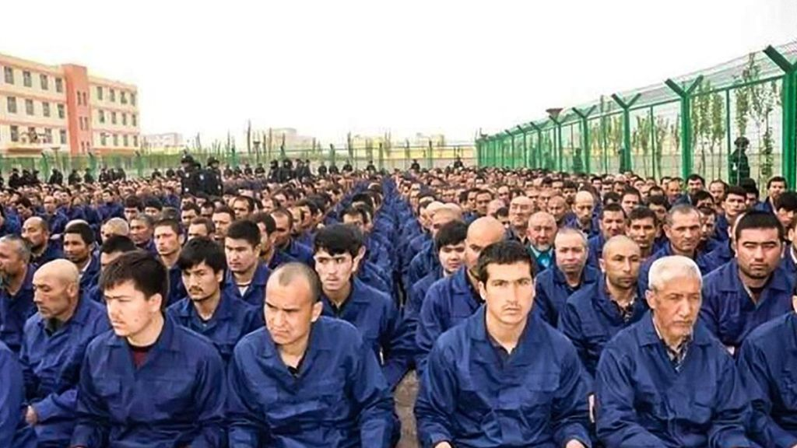

Greater Threat: Keeping Your Mind Private
Totalitarian states are inefficient when they target entire demographic groups for repression
  Cost
  Radicalization
  International pressure
AI enables precise micro-targeting of wrong-thinkers
Xinjiang Re-Education Camp

Slide 34
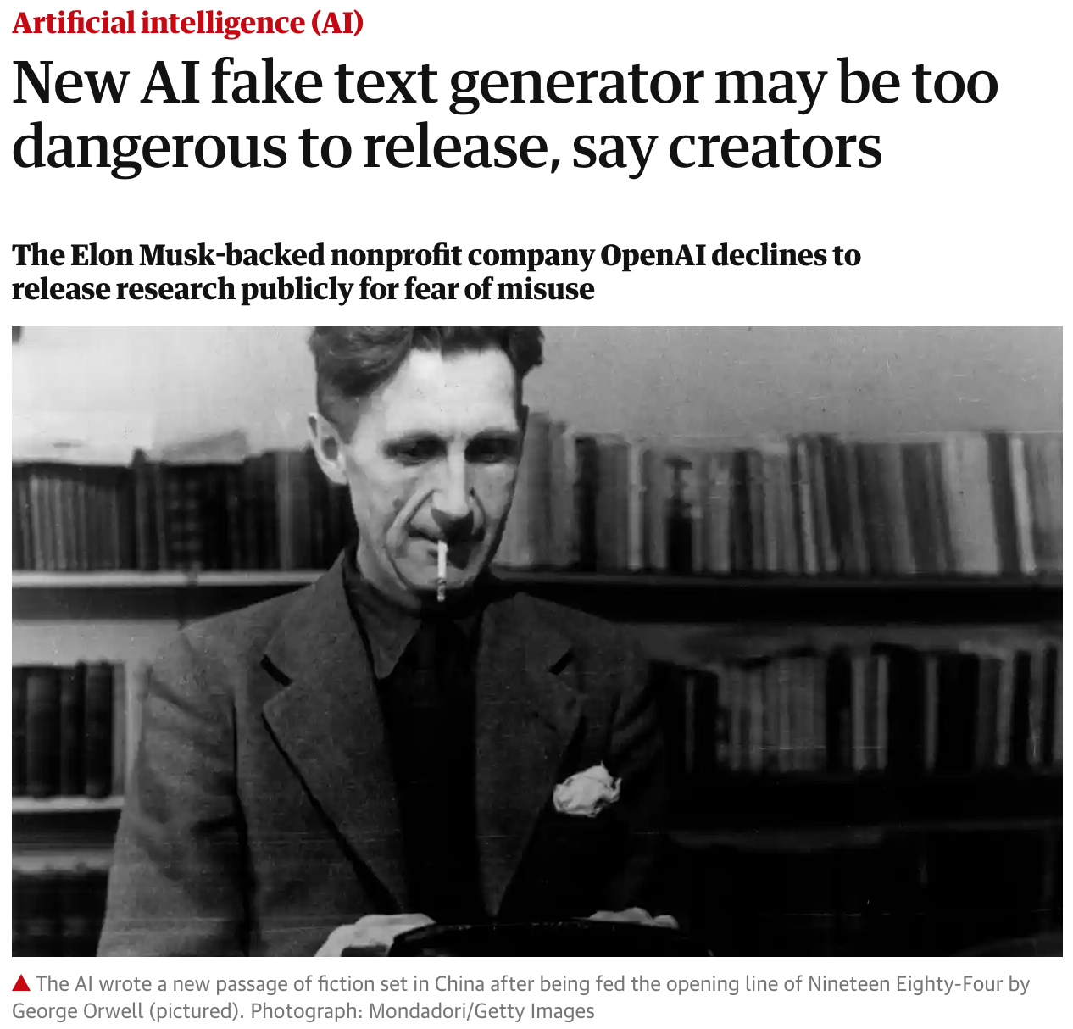
In the News: Fake News

Slide 35
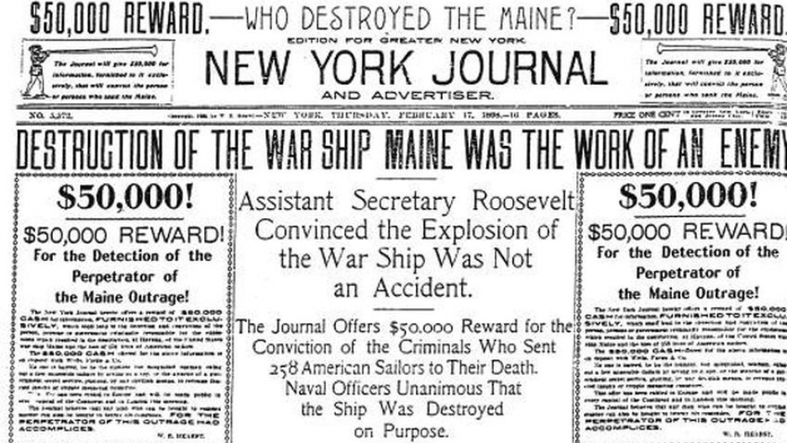
But Fake News is Old News

Slide 36
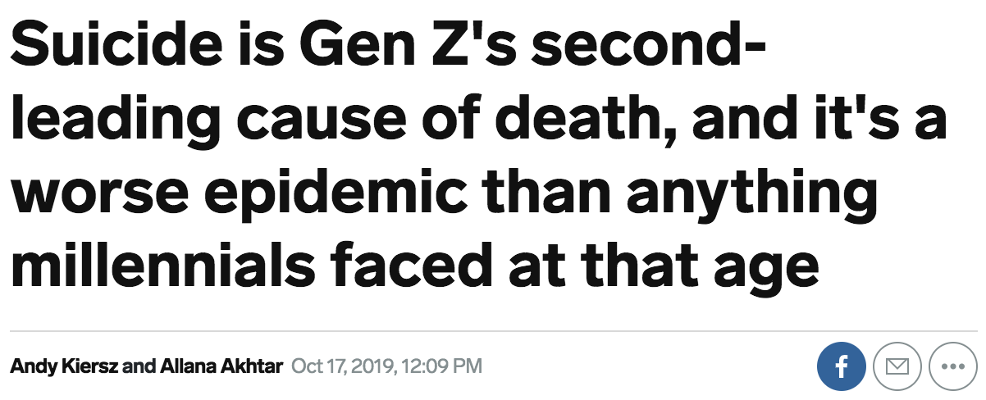

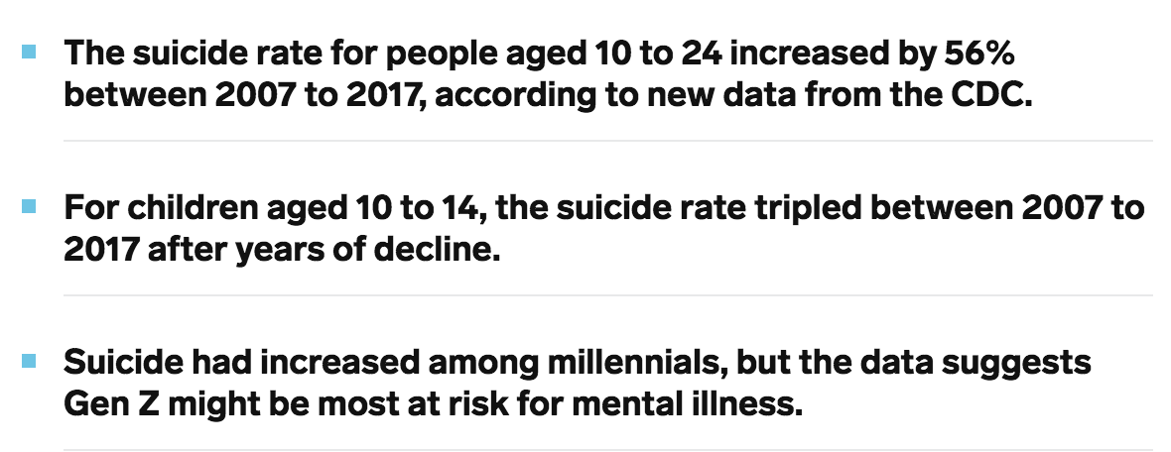
Greater Threat: Fake Friends

Slide 37

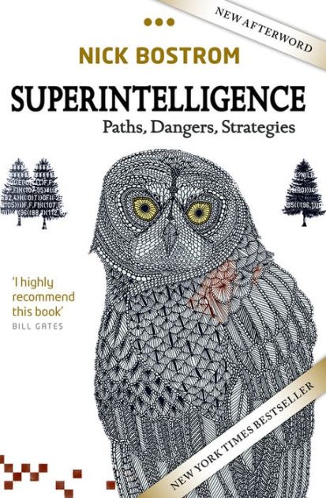
Greater Threat: Fake Friends
-
+
=

Slide 38
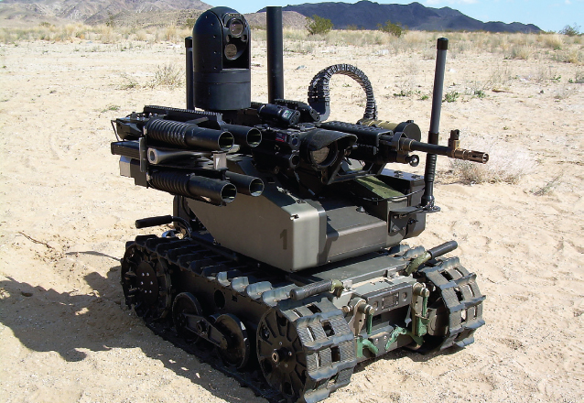
In the News: Autonomous Weapons
Defense Innovation Board AI Ethical Guidelines
Human beings should exercise appropriate levels of judgment and remain responsible for the development, deployment, use and outcomes of DOD AI systems.
Does this mean human-in the loop?
Modular Advanced Armed Robotic System Quentic North America

Slide 39
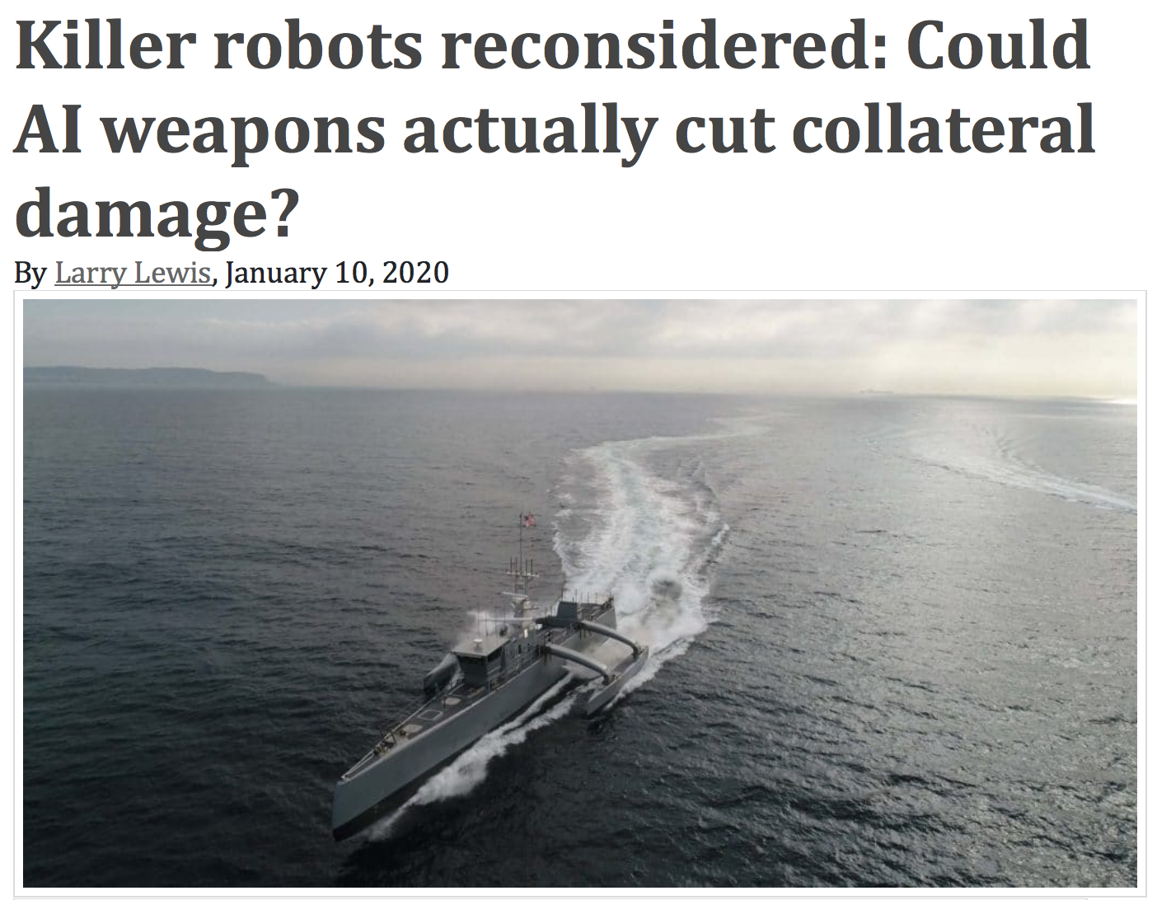
Ethical Military Use of AI != Human in the Loop
Larry Lewis
Senior Advisor for the State Department on Civilian Protection, Obama administration
Member US Delegation for UN Deliberations on Lethal Autonomous Weapons Systems
Artificial intelligence may make weapons systems and the future of war relatively less risky for civilians than it is today
The Bulletin of the Atomic Scientists, 10 Jan 2020

Slide 40
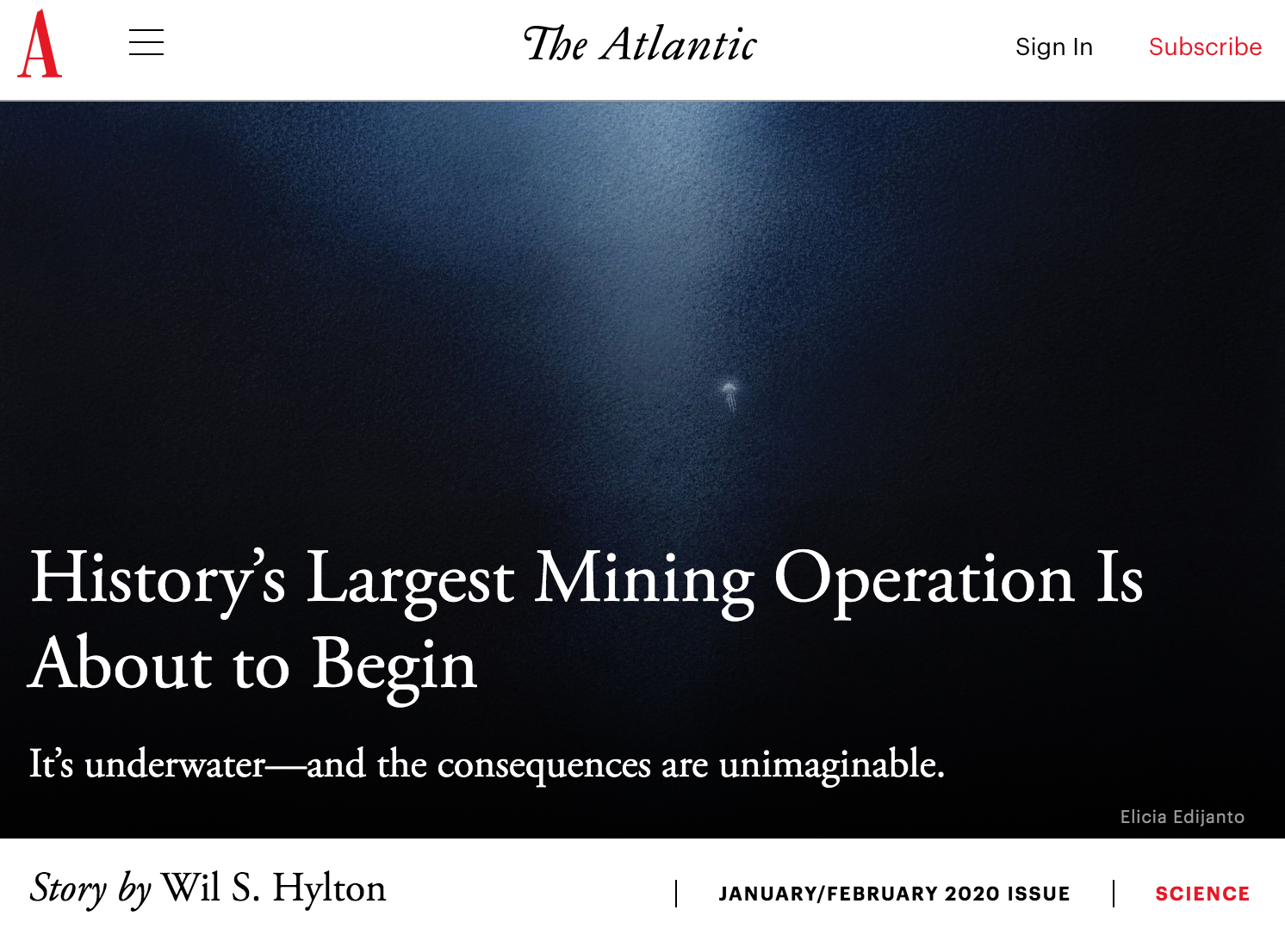
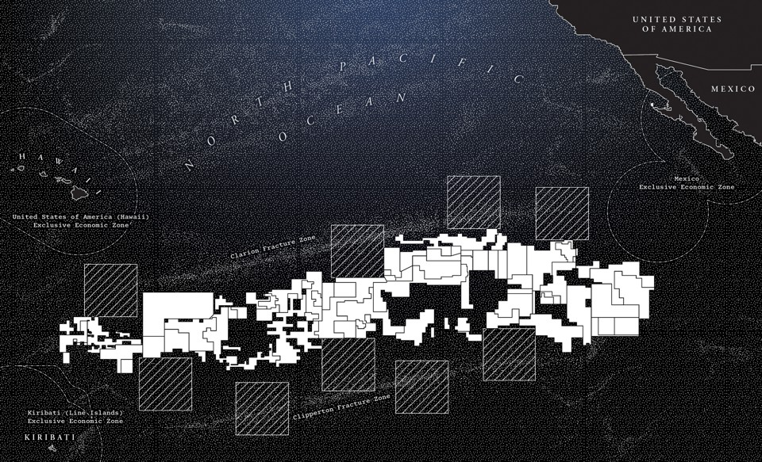

Greater Threat: Autonomous Weapons of Environmental War: Deep Sea Mining
AI is also a big part of the defense of oceans!
Woods Hole ”Sentry” UAV
The Mariana Trench

Slide 41
Part III: Future of AI

Slide 42
The Marcus-LeCun Twitter War
Editor’s note: artistic license has been applied to the quotations
Marcus: AI systems need to perform symbolic reasoning!
LeCun: Yes, been working on that.

Slide 43
Overview
Violent agreement on the need to bring together the neural and symbolic traditions
How do neuro and symbol systems interact?
  symbolic Neuro symbolic
  Symbolic[Neuro]
  Neuro ; Symbolic
  Neuro: Symbolic → Neuro
  Neuro_{Symbolic}
  My favorite: Neuro[Symbolic]

Slide 44
symbolic Neuro symbolic
Deep learning SOP (Standard Operating Procedure)
Image from https://blog.aylien.com/

Slide 45
Symbolic[Neuro]
Neural pattern recognition subroutine within a symbolic problem solver
AlphaGo (2016)
AlphaZero (2017)
Monte-Carlo Game Tree Search
NN State Estimator

Slide 46
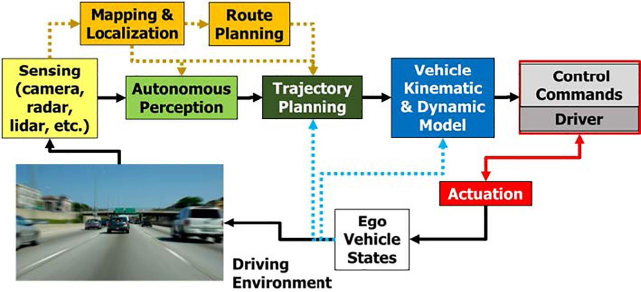
Symbolic[Neuro]
Image from https://deepdrive.berkeley.edu/

Slide 47
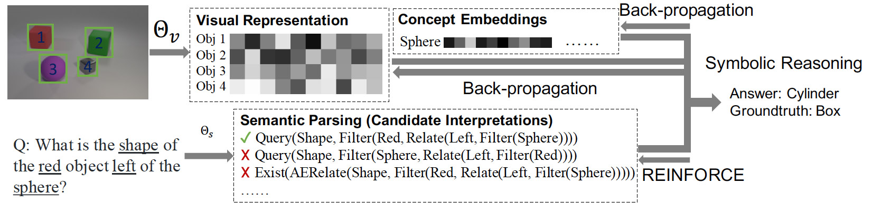
Neuro ; Symbolic
Cascade from neural network into symbolic reasoner
Neuro-Symbolic Concept-Learner (Mao, Gan, Kohli, Tenenbaum, Wu 2019)

Slide 48
Neuro: Symbolic → Neuro
Training compiles away symbolic rules
  Rule A → B becomes an input-output training pair (A, B)
  Deep Learning for Symbolic Mathematics (Lample & Charton 2020)
But no guarantee of correctness
input:⎰ x^{n} dx output: (1/n+1) x^{n+1}

Slide 49
Neuro_{Symbolic}
Symbolic rules are used as templates for structures within the neural network
  Tensor Product Representations (Smolensky et al. 2016)
  Logic Tensor Networks (Serafina & Garcez 2016)
Demonstrated for encoding abstraction and part-of hierarchies
Open: What about true combinatorial reasoning by cases?

Slide 50
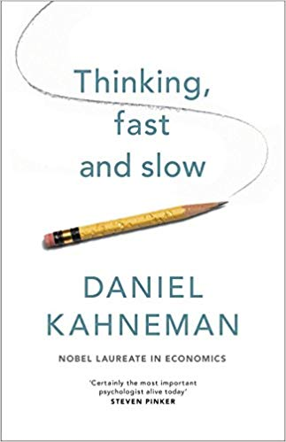
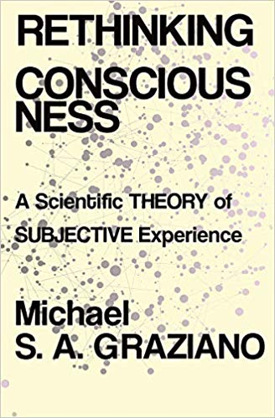
My Favorite: Neuro[Symbolic]
Imbed true symbolic reasoning inside a neural engine
Enable super-human and super-neuro combinatorial reasoning
  For deliberative, Type 2 reasoning
  Rare in ordinary animal life
  Common in “business AI”
Interface at the Attention Schema
  Internal model of the system’s state of attention
  Not the same as attention itself!

Slide 51
Neuro-Symbolic Interface
Proposal: When attention to concepts is very high, they are decoded to symbolic entities in an attention schema
Appearance of a goal in the attention schema signals that deliberative symbolic reasoning should be initiated
  I’m not just perceiving or remembering, I’m consciously thinking!
Efficient combinational search can then be performed over the entities in the attention schema

Slide 52
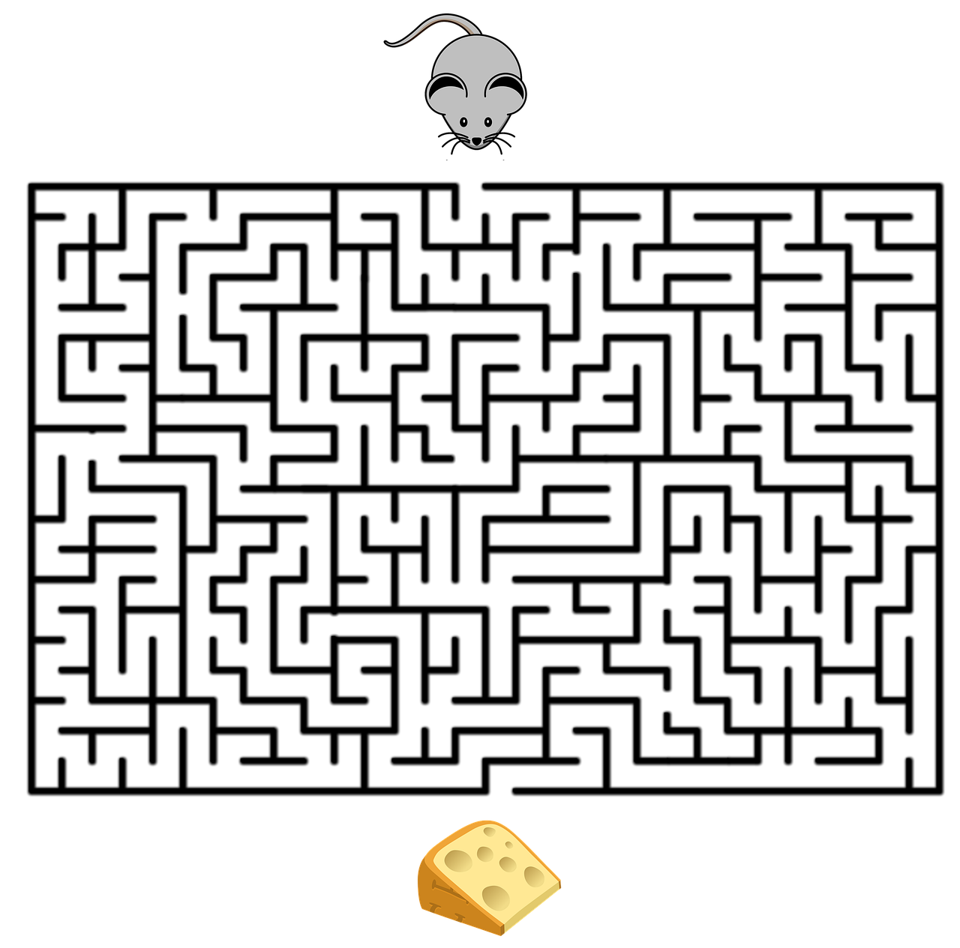
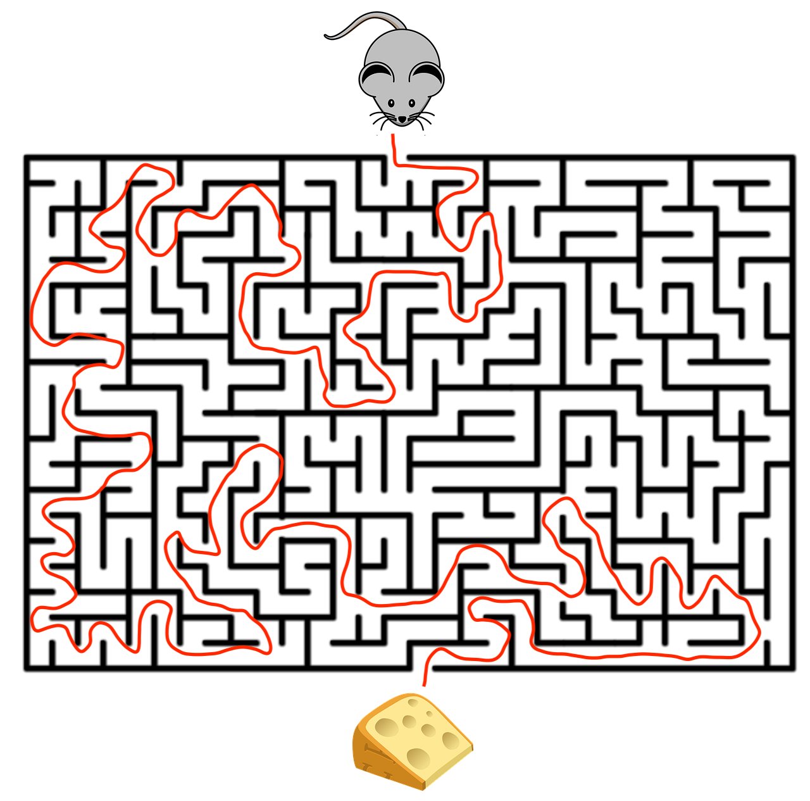
Symbolic Reasoning Engine
Go_To(Cheese)
Decoder
Encoder
Neural Network
Forward(1)
Turn left
Forward (3)
…

Slide 53
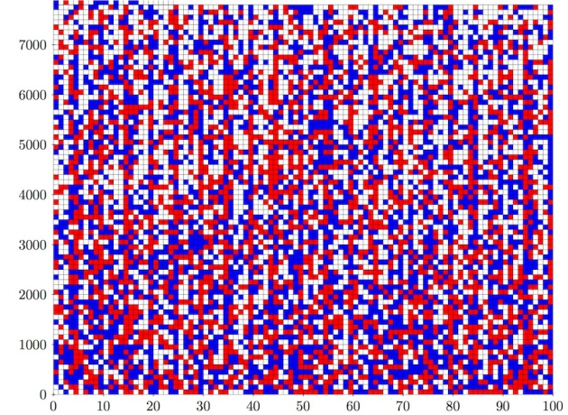
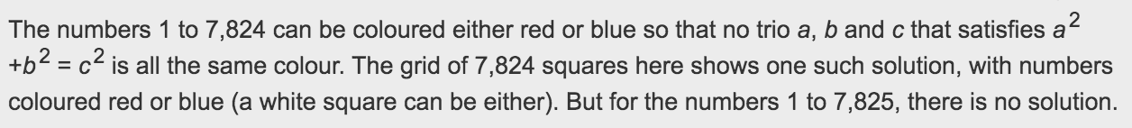
Discussion
Why not maintain a (possibly reduced) vector representation in the attention schema?
  Recurrent Independent Mechanisms: Bengio, Schölkopf et al.
In order to leverage efficient constraint-satisfaction algorithms
  200 terabyte proof of the Boolean Pythagorean Triples Problem (Huele et al. 2016)

Slide 54
Discussion
The proposed symbolic solver is not differentiable, so it won’t support gradient descent-based learning
You wouldn’t want to back propagate through a trillion inference steps anyway.
The neural network can learn from inputs/outputs of SRS using non-gradient based optimization
This scheme does not handle non-logical reasoning
Could be extended to probabilistic reasoning, but probably not similarity-based reasoning
Goal is expert reasoning, not commonsense reasoning: a step toward superintelligence, not human intelligence

Slide 55
Summary
Each AI summer has led to enduring scientific insights
Today’s third summer is different
  It might not be followed by a winter
  It enables powerful applications for good and bad
The next steps in AI are tighter symbolic-neuro integration

Slide 56
Thank You
If I have seen further it is by standing on the sholders of Giants.
- Isaac Newton, February 5, 1675, in a letter to Robert Hook.
Hooke never replied.

