Slide 1
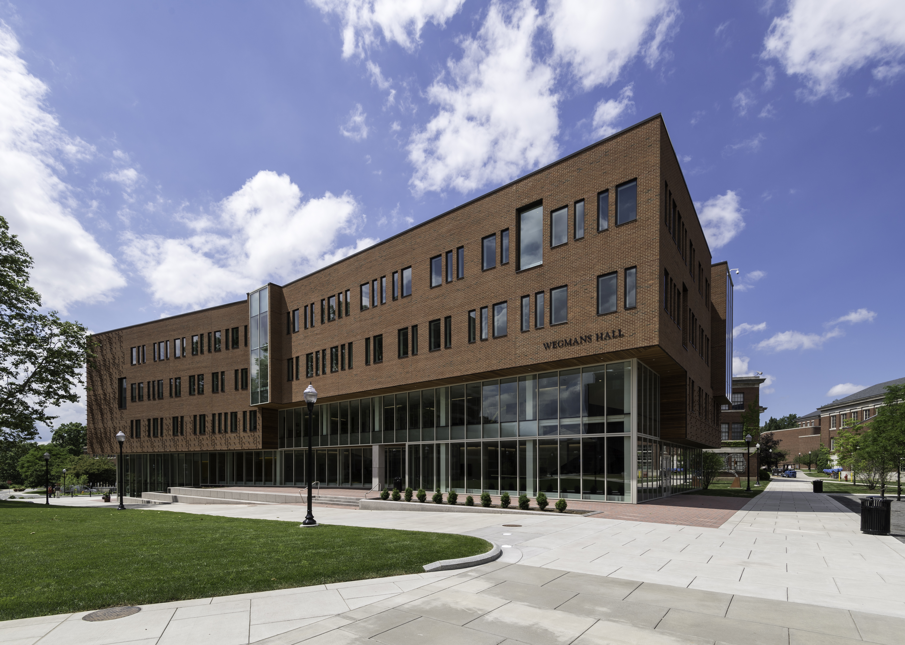

Henry Kautz
Robin & Tim Wentworth Director
Data Science: The Defining Discipline of the 21st Century

Slide 2
What is Data Science?
Data Science: Methods, Applications, and Infrastructure for Extracting Meaning from Large Scale Data
Data
Knowledge
Action

Slide 3
How Did Data Science Arise?
Computer
Science
Data
Science
Sciences,
Engineering,
Humanities,
Medicine,
Business
Statistics

Slide 4
Data Science is Transforming

Slide 5
Data Science is Transforming
Business

Slide 6
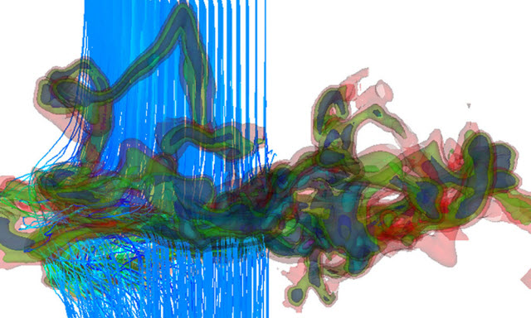
Data Science is Transforming
Science
Notes:
Adam Frank (Physics) – simulation of origin of universe

Slide 7
Data Science is Transforming
Government

Slide 8
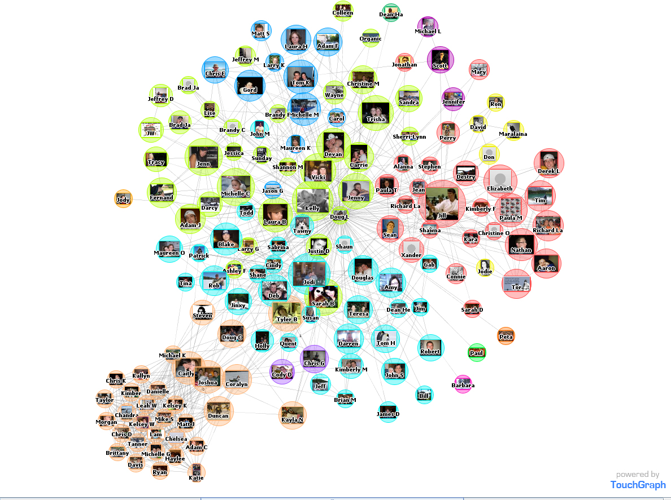
Data Science is Transforming
Society
Notes:
Facebook friendship graph, cliques in different colors

Slide 9
Growing Demand for Data
Scientists

Slide 10
New Kinds of Data
Notes:
Unstructured – natural language processing – translation and understanding – Dan Gildea (Computer Science)
From the Wild – Apple Healthkit – Parkinson’s app by Ray Dorsey (Neurology)
High Dimensional – brain imaging – Raj Raizada (Brain & Cognitive Science)

Slide 11
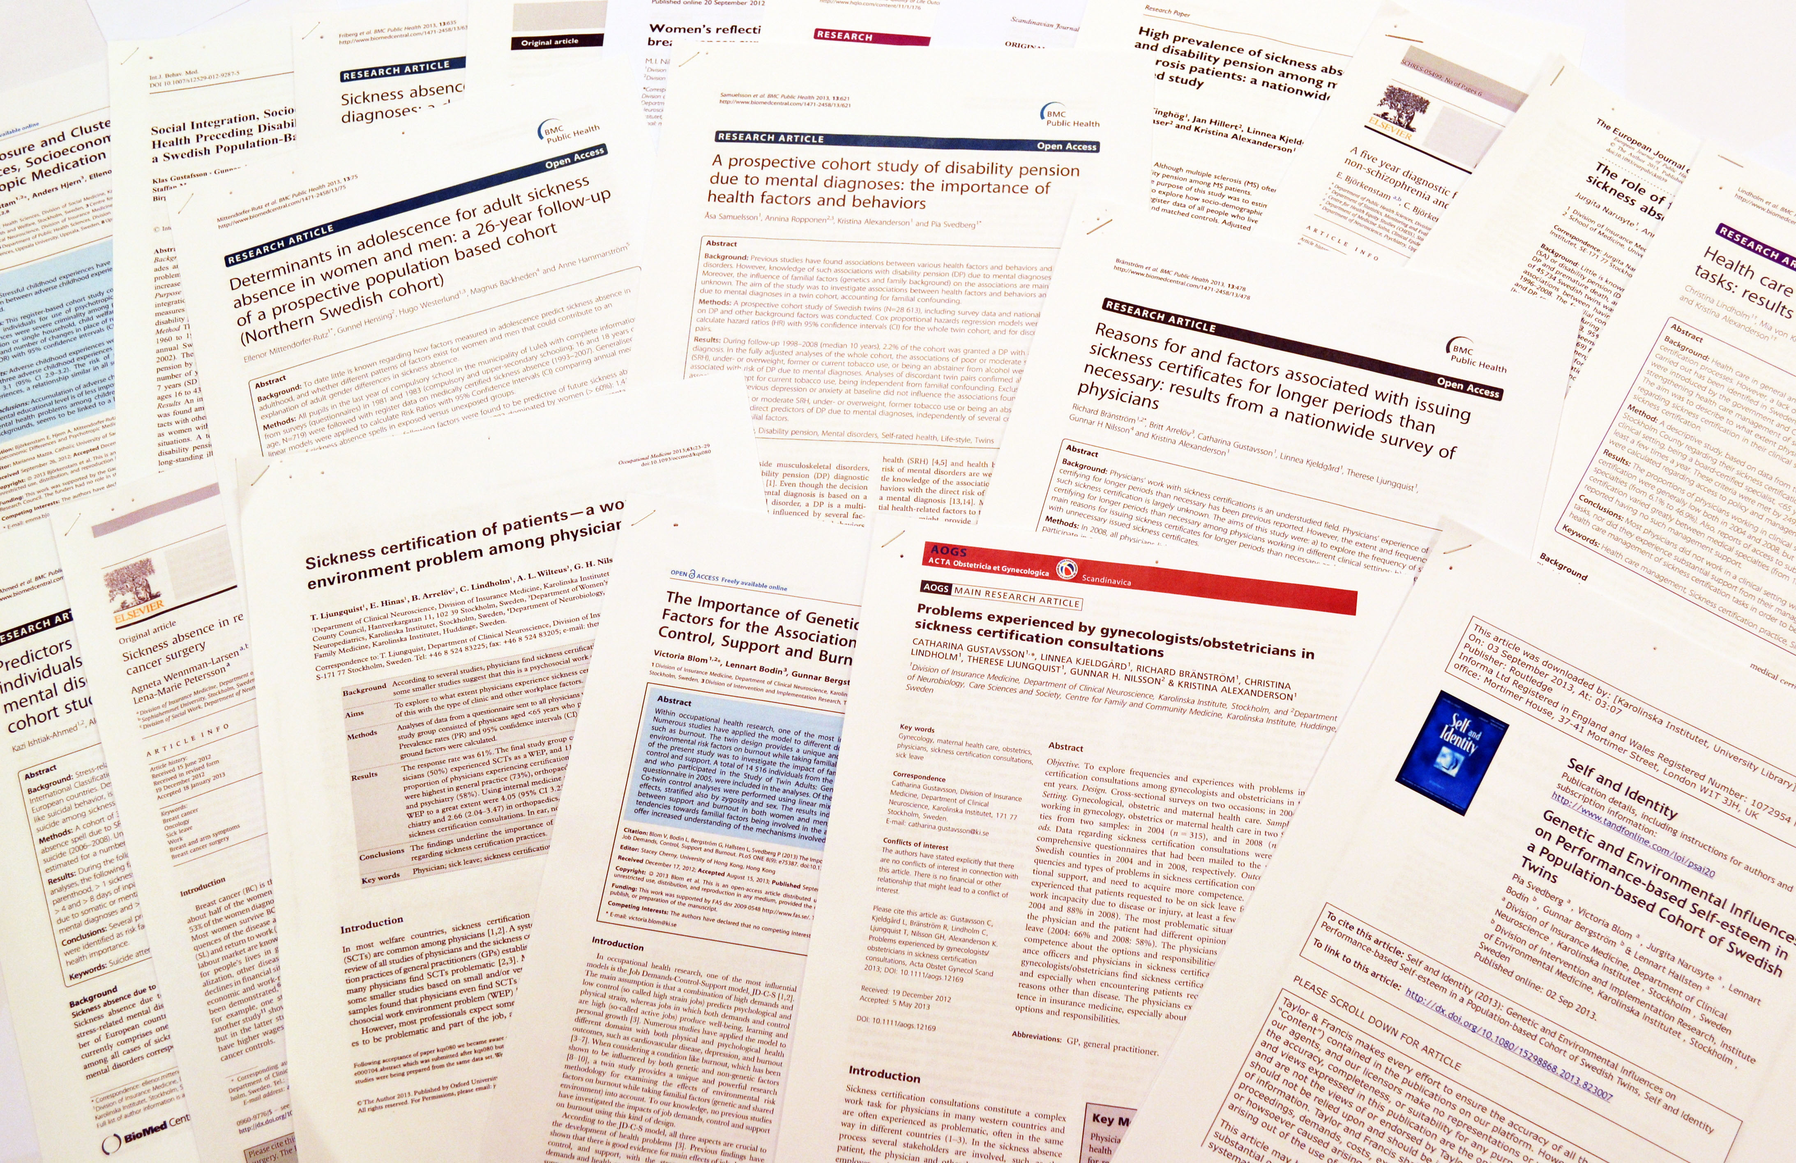
New Kinds of Data
Unstructured
James Allen, UR CS, Machine Reading of Medical Reports
Notes:
Unstructured – reading natural language scientific articles – James Allen (Computer Science)

Slide 12
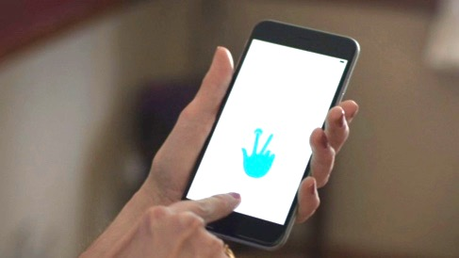
New Kinds of Data
Unstructured
From the Wild
Ray Dorsey, UR Medicine, Parkinson's Disease App
Notes:
From the Wild – Apple Healthkit – Parkinson’s app by Ray Dorsey (Neurology)

Slide 13
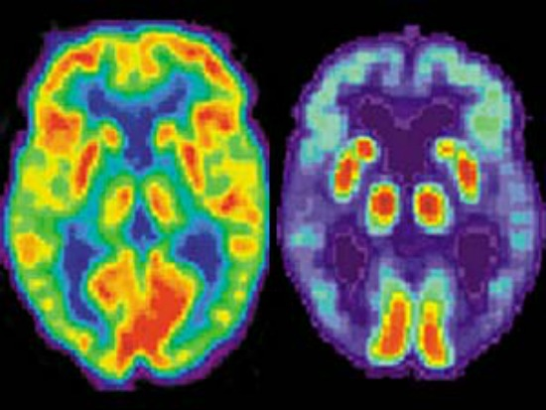
New Kinds of Data
Unstructured
From the Wild
High Dimensional
Raj Raizada, UR Brain & Cognitive Science, fMRI for language understanding
Notes:
High Dimensional – brain imaging – Raj Raizada (Brain & Cognitive Science)

Slide 14
New Ways of Understanding Data

Slide 15

New Ways of Understanding Data
Traditional Approach
Data
Knowledge
Custom Program

Slide 16
New Ways of Understanding Data
Machine Learning
Examples Input /Output
Data
Knowledge
Machine Learning System

Slide 17
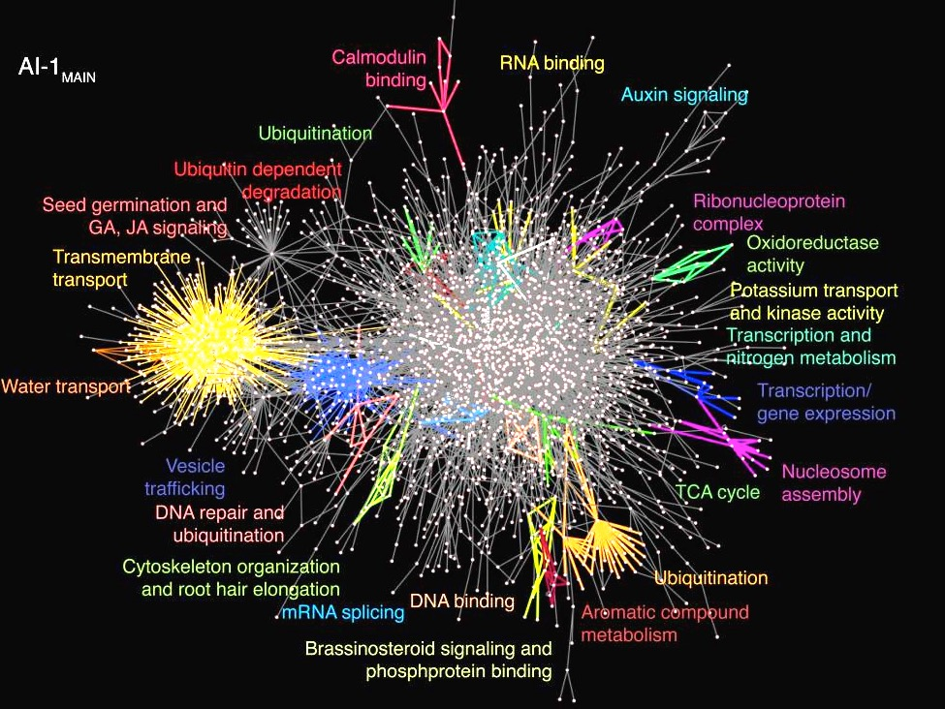
News Kinds of Interdisciplinary Research
Physics,
Network Science, Biology
Gourab Ghoshal

Slide 18
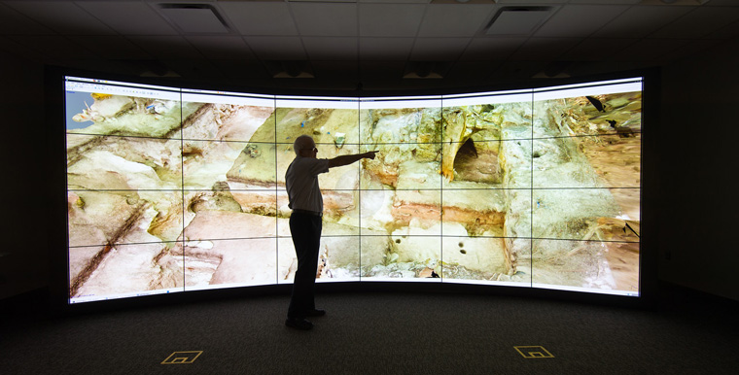
News Kinds of Interdisciplinary Research
Archeology,
Digital History,
Virtual Reality
Mike Jarvis

Slide 19


A Case Study:
TwitterHealth

Slide 20
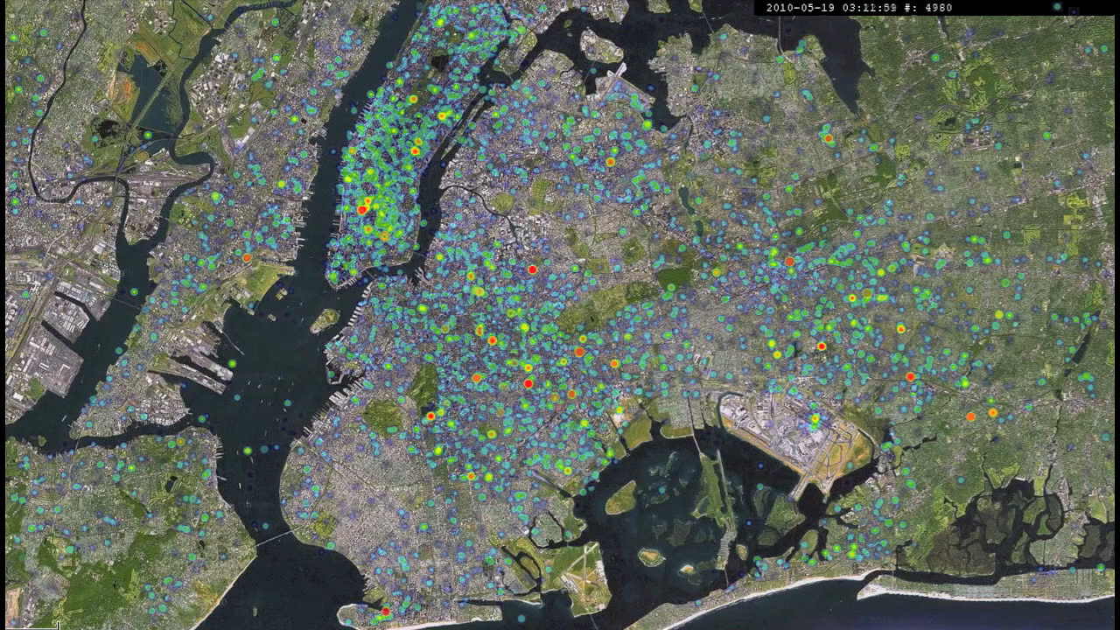
People on Smartphones: An Organic Sensor Network

Slide 21


Analyzing Tweets
Goal: find tweets about disease symptoms
  Previous approach: keywords
  Problems: “sick of homework”, “under the weather”
Our approach: machine learning
  Use Mechanical Turk workers to train the system
  98% accuracy
Training Data
Sick Tweets
Contains
“sneeze”?
“sick”?
“tired”?
Machine Learning System

Slide 22

sick
+0.8
+0.8

Slide 23
sick and tired
+0.7
+0.8
+0.6
-0.7

Slide 24
sick and tired of
-0.1
+0.8
+0.6
-0.7
-0.8

Slide 25
sick and tired of flu
+0.6
+0.8
+0.6
+0.7
-0.7
-0.8
How do we get these numbers???

Slide 26
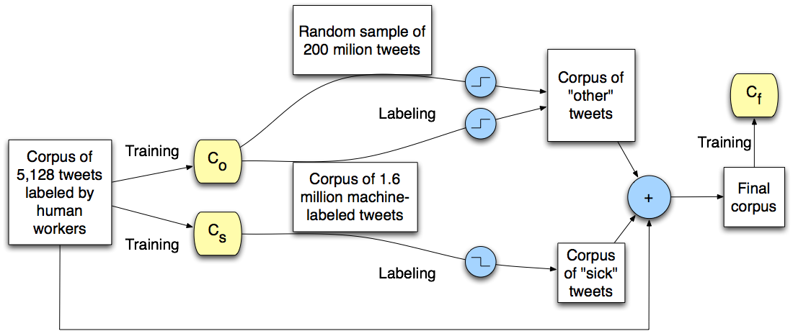
Semi-Supervised Learning
Notes:
5K & 1.6M corpora courtesy of [Michael J. Paul and Mark Dredze, 2011]

Slide 28
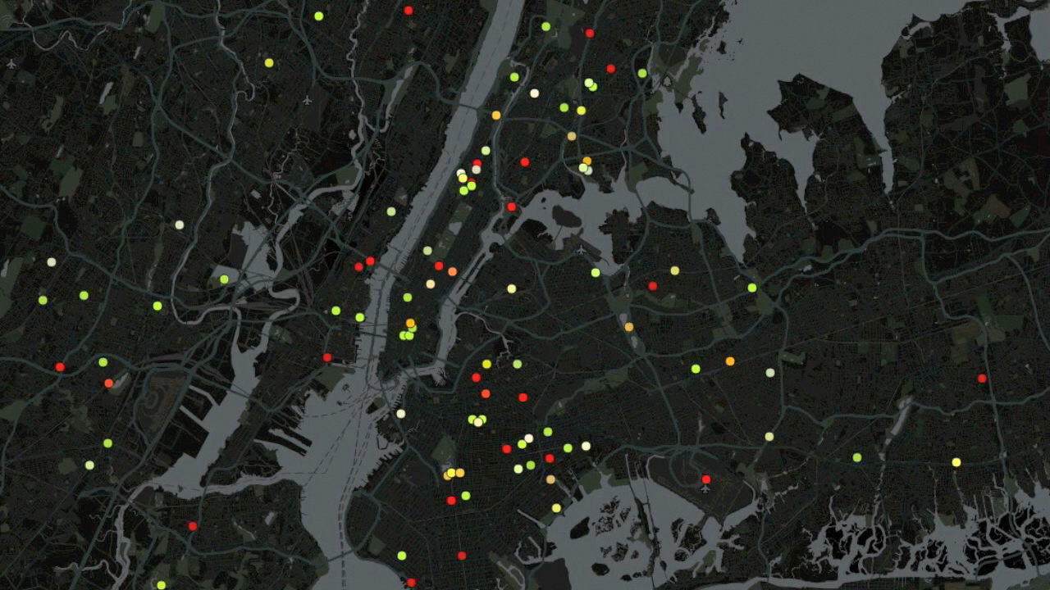

Slide 29
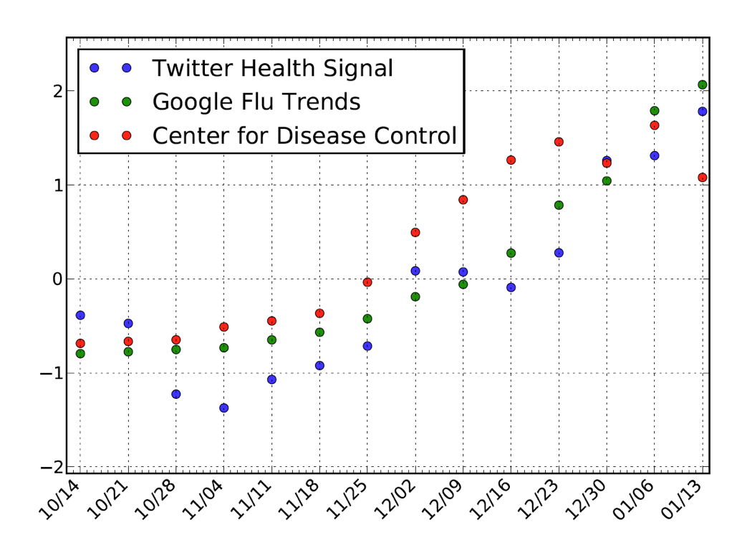
Validating Tf
NYC, Boston, Los Angeles, Seattle, San Francisco
Tf correlated with Cf (R=0.80, p=0.002)
Tf correlated with Gf (R=0.87, p=0.0002)

Slide 30
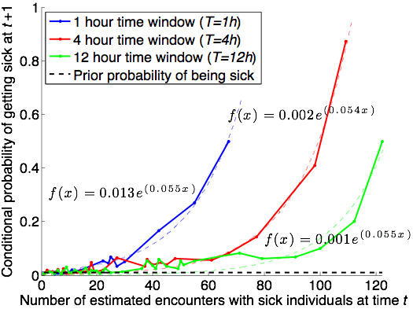
Impact of Co-Location
Impact of encountering 50+ sick users is strong

Slide 31

Foodborne Illness
Affects 48 million people annually in US
128,000 hospitalizations
3,000 deaths

Slide 32
Fighting Foodborne Illness
Primary tools
  Education of general public
  Inspections of food venues
Challenges
  Food venues inspected yearly: can predict and prepare for inspection
  Unlicensed venues
How can we target inspections more effectively?
Can we find problematic unlicensed venues?

Slide 33
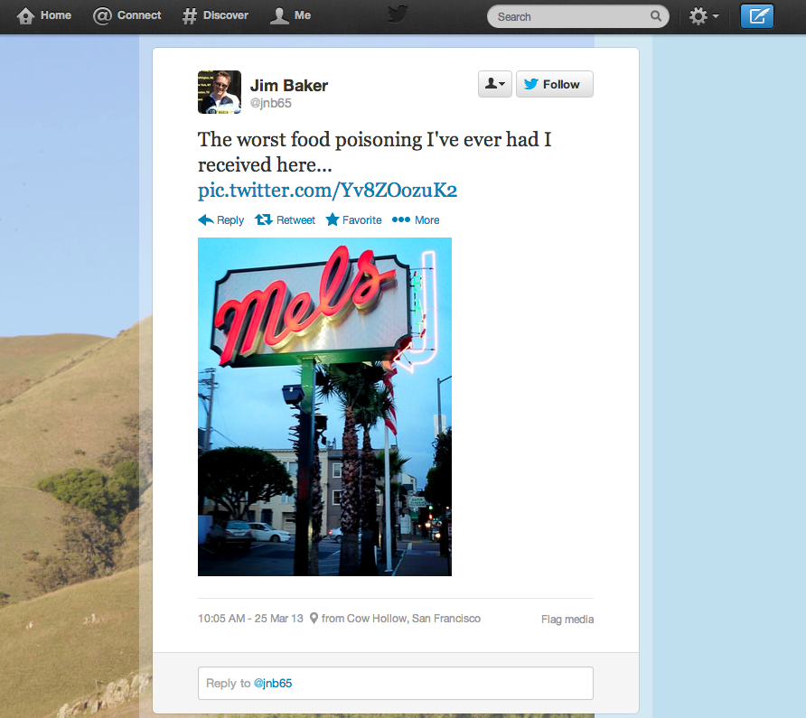

Slide 34
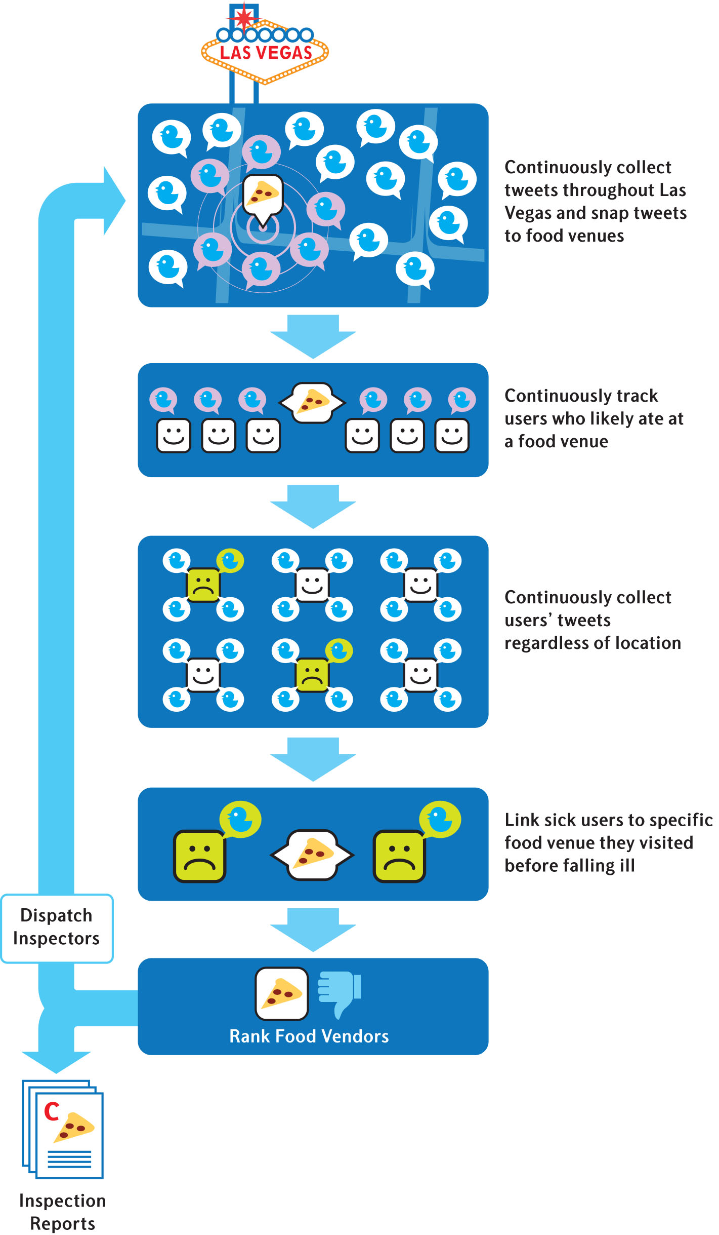

Slide 35
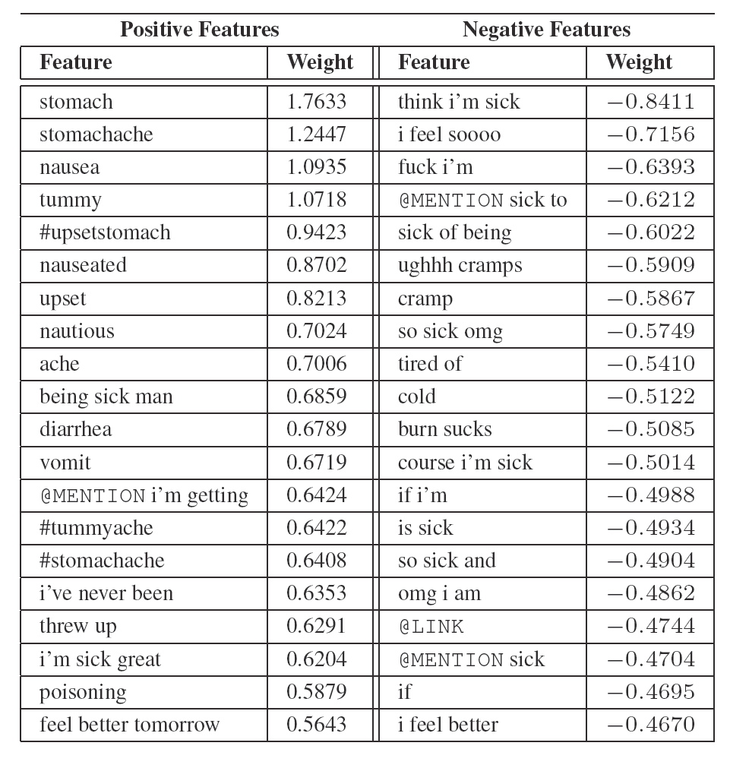

Slide 36
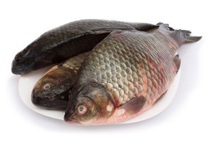
Results
Adaptive inspections uncover more violations
  9 demerits vs 6 demerits (p = 0.019)
  Significantly more “C grades” discovered: 11 vs 7
Adaptive inspections estimated to prevent 71 infections and 4.4 hospitalizations during trial
nEmesis alerted health department
to an unlicensed seafood venue

Slide 37
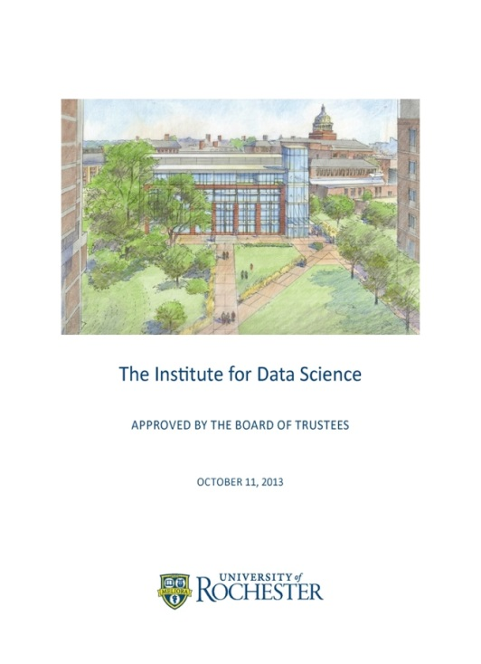
Creating the Goergen Institute for Data Science
2012: The Rochester Big Data Initiative
  Start strategic planning around data
  science in research and education
  Big Data Forums 2012 & 2013
October 2013:
  “The signature project of the 2013-2018 University Strategic Plan will be the
  creation of a University-wide
  Institute for Data Science”

Slide 38
Goals of the Institute
Create and run new Bachelors and Masters programs in Data Science
Support interdisciplinary research in Data Science
  Seed funding
  Leverage combination of Arts, Sciences & Engineering and Medical School
Grow industry partnerships and commercialization

Slide 39
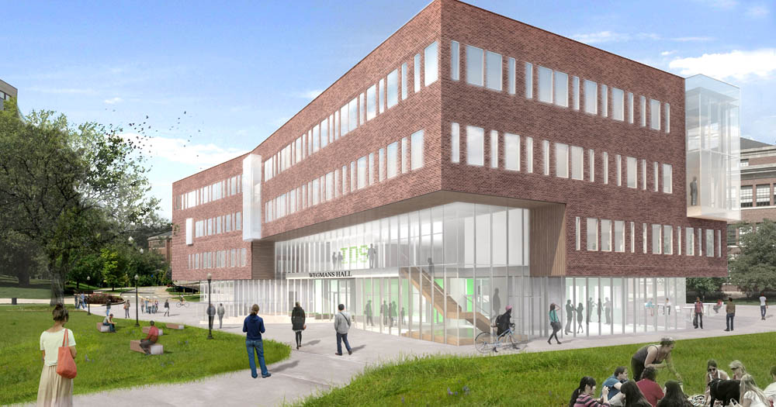
Today
MS in Data Science – 25 students per cohort
BS / BA in Data Science – 40 majors and growing
New York State Center of Excellence in Data Science
Seeded 12 interdisciplinary research projects
Practicum classes with industry partners
NSF National Research Training and Research Experience for Undergraduates awatds
Wegmans Hall – 60,000 sq ft, $25 million home to CS

Slide 40
BS in Data Science
Blend
  1/3 Computer Science
  1/3 Statistics
  1/3 Application Area
Students work in teams on industry problems in Capstone and Practicum
Students emerge with strength in both fundamentals and practice
Number majors doubling each year
30% female
Computer
Science
Data
Science
Sciences,
Engineering,
Humanities,
Medicine,
Business
Statistics

Slide 41
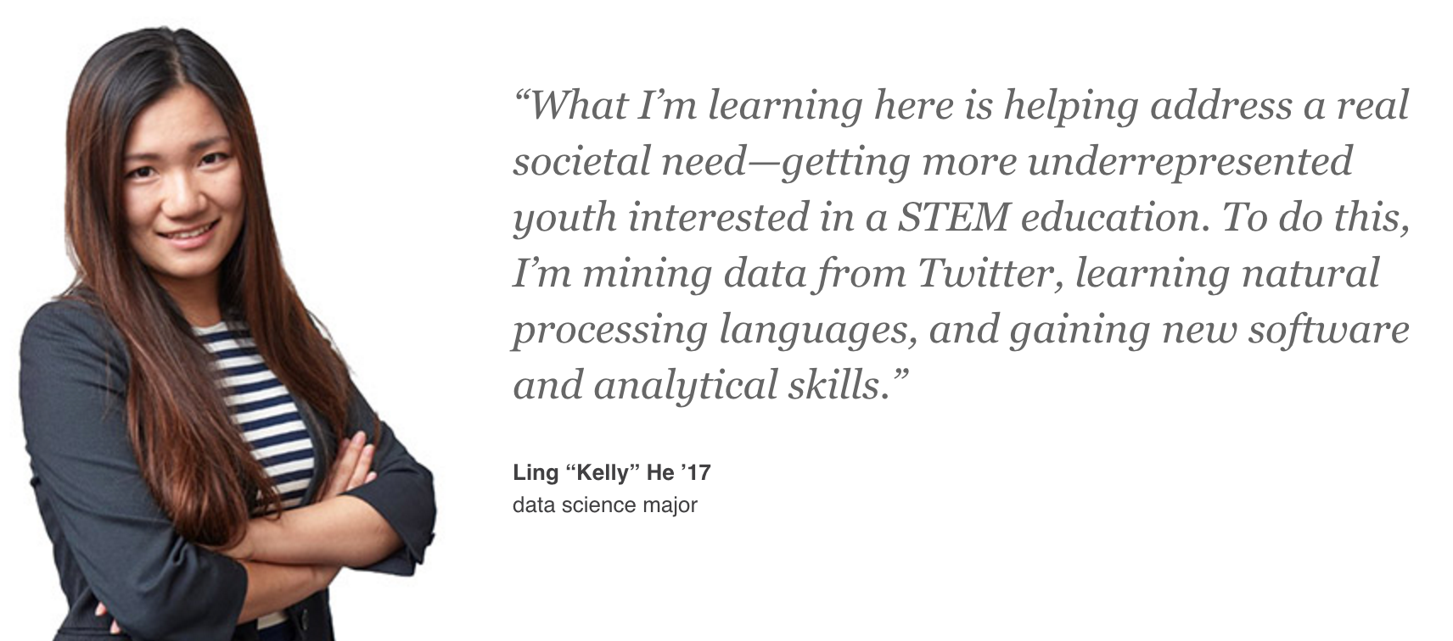

Slide 42
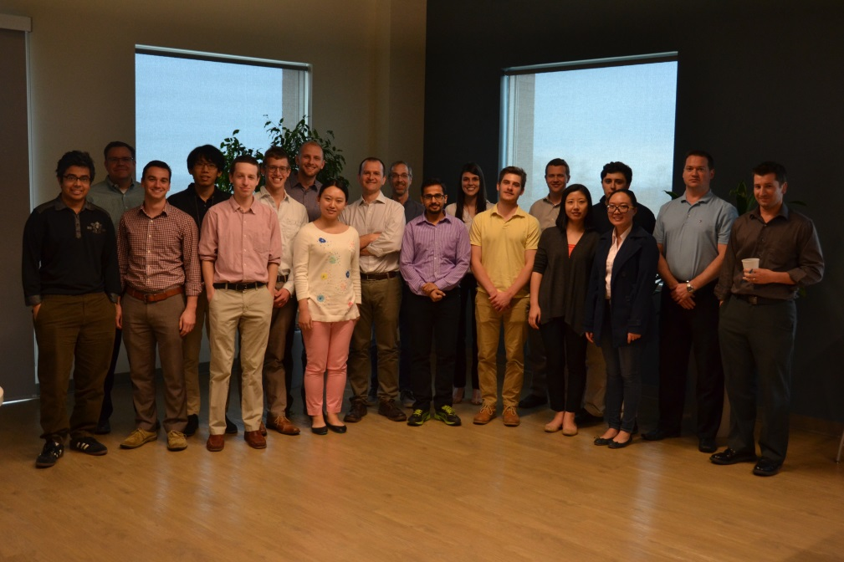
MS in Data Science
Curriculum
  Data Mining
  Data Bases
  Statistics in R
  Tools for Data Science
  Industry Practicum
2017 Practicum Partners
  Soleo Communications
  Brand Networks
  Visual Dx
  City of Rochester Police Department
  Arable
Practicum students and mentors at Soleo Communications

Slide 43
Faculty Expansion
Expertise in data science is distributed among many departments and divisions
Goal: expand number of faculty whose labs will be hubs of interdisciplinary, collaborative research in data science

Slide 44
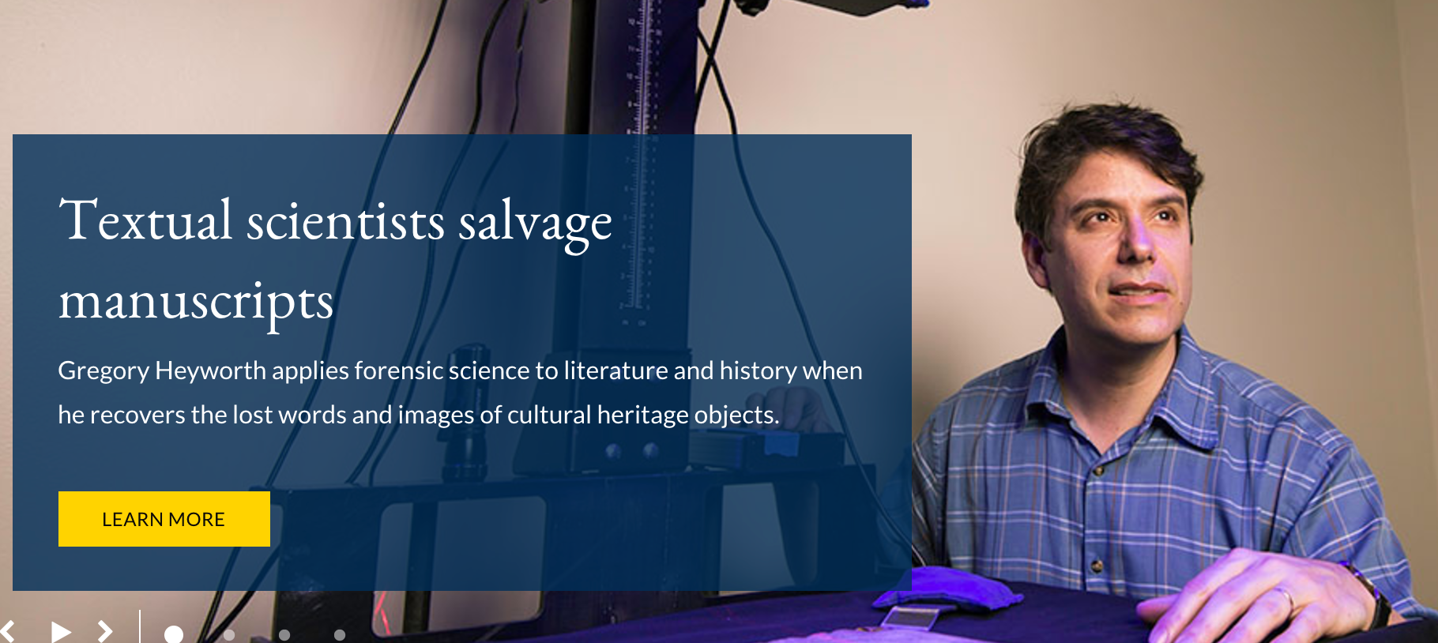
Interdisciplinary Hiring
2015 Gourab Ghoshal: Network Science
2015 Tom Howard: Human-Robot Interaction
2016 Greg Heyworth: Digital Analysis of Ancient Manuscripts
2017 Aaron White: Computational Linguistics

Slide 45
CoE Pilots
Pilot projects team URMC faculty with researchers in CS and ECE
  Identifying major depression and bipolar disorders from video analysis
  Predicting treatment outcomes for epilepsy patients
  Deep learning to predict adverse events in EKG data
  Mobile app to improve diet for migrant women with low literacy
  Mental health evaluation using web data

Slide 46
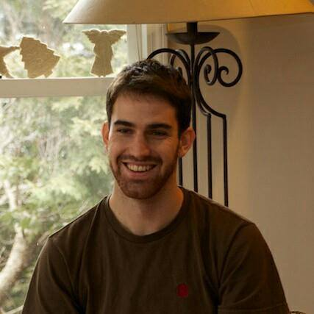
Winning External Support
2015-2019: $3.2 NSF Research Traineeship Award
  Data-Enabled Research into Human Behavior and its Cognitive and Neural Mechanisms
  Cross-training in Computer Science and Brain & Cognitive Science
In this course, I took on my first significant project leadership role. I learned how to better explain technical concepts, and how to delegate work effectively.
– Richard Lange, PhD Student

Slide 47
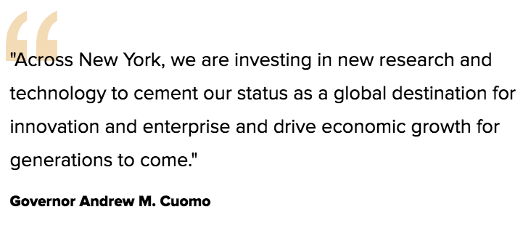
Data Science Consortium
Sept 2017: Governor Cuomo Announces $22.5 Million for Rochester Data Science Consortium
Wegmans Family Charitable Foundation Commits Additional $10 Million, Bringing Its Total Gift to $20 Million
Initial partner: Harris Corporation Space & Intelligent Systems Division

Slide 48
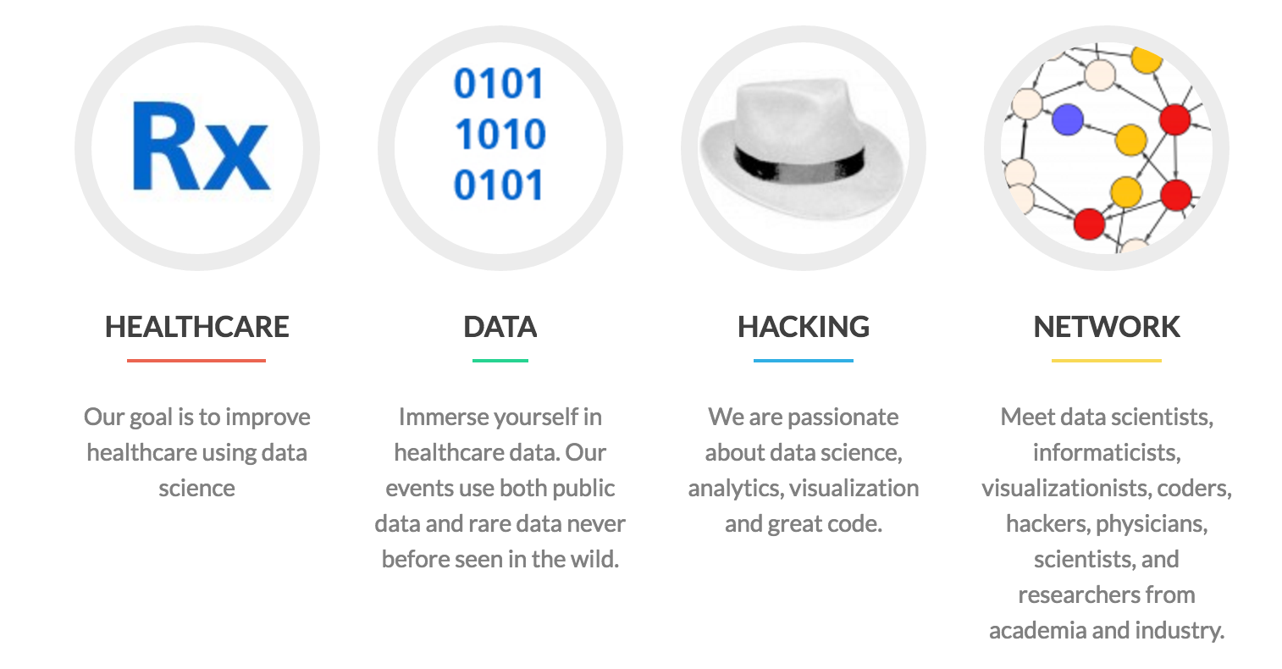
Events
RocHackHealth and Health Data Dive
  Co-sponsored by Rochester Center for Health Informatics and Goergen Institute for Data Science

Slide 49
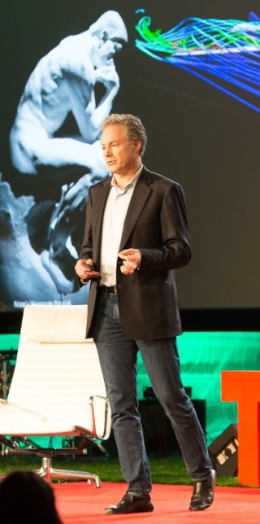
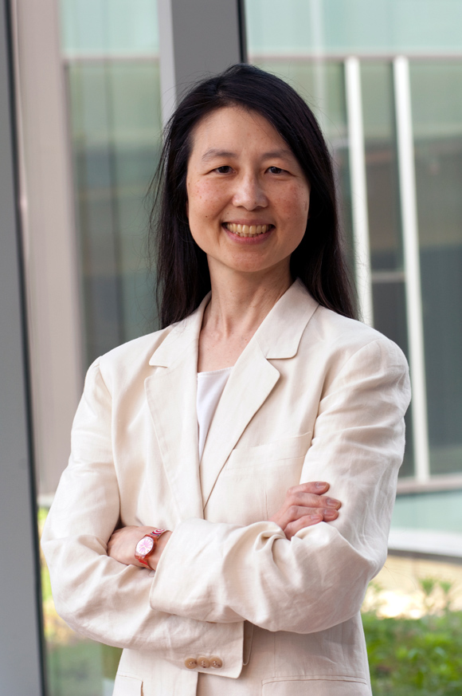
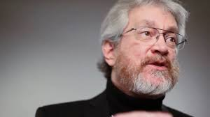
Data Science Distinguished Speakers
  2015: Eric Horvitz, Head of Microsoft Research
    Data Science for Social Good
  2016: Sandy Pentland, Founder MIT Media Lab
    Reinventing the social contract in an age of big data
  2017: Jeannette Wing, Head of Columbia Data Science Institute, former head NSF CISE, former head Microsoft Research

Slide 50
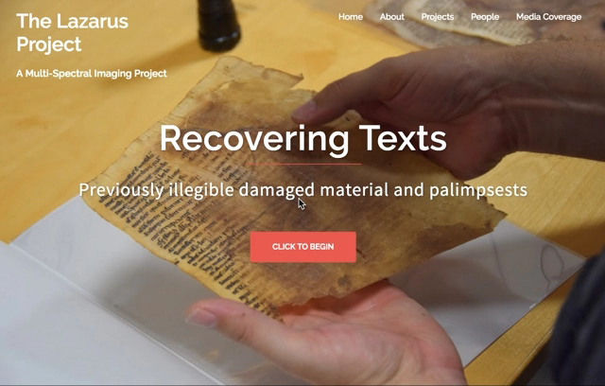
2017-2019: NSF Research Experience for Undergraduates
REU Site: Music, Media, and the Mind
  Computer Science
  Audio Engineering
  Eastman School of Music
  Digital Media Studies
See our website for details
Applications close February 15

Slide 51
Graduate Opportunities
MS in Data Science
  Requirements: Math through Calculus,
  2 programming courses
PhD in Computer Science
  Requirements: BS in Computer Science (or a strong minor), GPA > 3.0

Slide 52
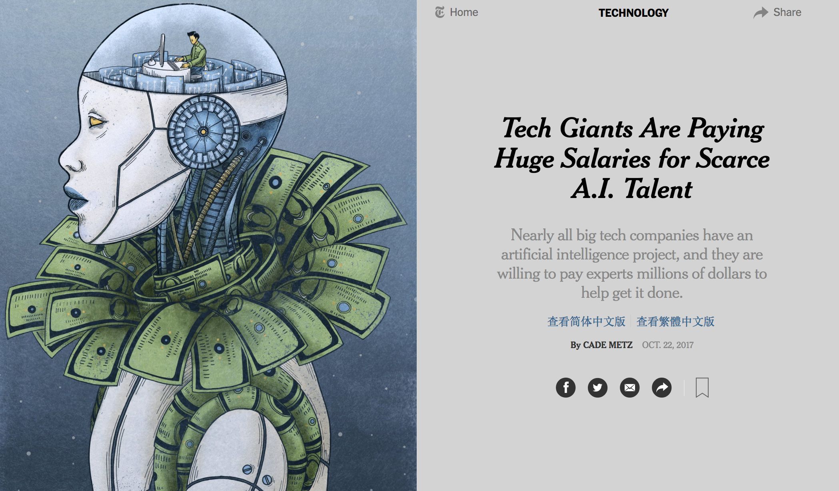

Slide 53
AI at University of Rochester
James Allen: Dialogue Systems
Dan Gildea: Natural Language Translation
Lane Hemaspaandra: Social-Choice Systems
Tom Howard: Human-Robot Interaction
Ehsan Hoque: Emotionally-aware Computer Systems
Henry Kautz: AI for Healthcare
Ji Liu: Theory & Algorithms for Machine Learning
Jiebo Luo: Multimedia Analytics
Len Schubert: Commonsense Reasoning
Chenliang Xu: Computer Vision

Slide 54
URCS PhD Program
No application fee for PhD
Admitted students guaranteed 5 years of full support – scholarship plus stipend
Prior MS not required
Option for Joint PhD with Linguistics or with Brain & Cognitive Science
Deadline: December 1st
http://www.cs.rochester.edu/graduate/how-to-apply.html

